Slide 1
2023 EITI Standard
Contract transparency

Slide 2

Why is contract transparency important?
REFLECTION
Notes:
Ask the audience to respond to this questions and summarise their replies.

Slide 3

Why is contract transparency important?
REFLECTION
Contract transparency can be a powerful antidote to corruption in resource-rich countries.
Publishing the rules and terms of extractive projects supports responsible investment.
Publishing the terms of extractive contracts helps governments maximise revenue from the extractive sector to meet development needs.

Slide 4

For governments & citizens
REFLECTION
Helps all parties to understand the terms on which oil, gas and mining activities take place.
Public contracts can be more easily enforced.
Citizens can understand what obligations are placed on companies to protect communities and the environment, including social payments or local employment

Slide 5

For companies
REFLECTION
Create clean and fair operating and investment climate
Contract disclosure makes it easier for companies to show that they comply with their financial and social obligations
Enhance social license to operate

Slide 6


Requirement 2.4
Objective
Ensure the public accessibility of all licenses and contracts underpinning extractive activities
Contribute to stakeholders’ ability to monitor compliance with contractual obligations.
Notes:
Enhance stakeholders’ ability to monitor compliance with contractual obligations
Empowers citizens to assess whether they are getting a ‘good deal’ for their resources
Enables analysis of alignment between contracts and national energy transition commitments
Summary
Encouraged disclosures:
Material exploration contracts
Terms of sale of state’s share of production or other in-kind revenues
Infrastructure and barter provisions in contracts (including resource-backed
loans)
Expected disclosures:
Agreements mandating social and environmental payments
Understand the legal and institutional framework to fight corruption
EITI reports can provide comprehensive data on laws, regulations and institutional mandate to address corruption in the extractive industry. By analysing this information, stakeholders can assess the effectiveness of existing legal and institutional frameworks in curbing corruption.
Promoting accountable license and contract awards
License and contract awards are often susceptible to corruption. This challenge is particularly apparent in the transition minerals sector where growing demand can drive an uptick in investments. EITI disclosures play a role in mitigating these risks by strengthening transparency on license and contract awards.
EITI reports include information on license allocations, detailing who holds the rights to exploit natural resources. Stakeholders can scrutinise this data to identify any lack of transparency or fairness in the license allocation process.
The information disclosed by the EITI helps in detecting vulnerabilities, such as non-competitive bidding or favouritism, that could lead to corruption in the allocation of resource licenses.
Disclosures related to award criteria and processes can enable stakeholders to understand whether decision-making is transparent and competitive.
Strengthening SOE governance
A significant proportion of recent corruption cases in the oil, gas and mining sectors have involved SOEs. As SOEs pursue new business opportunities in the context of the energy transition, corruption risk may surface in areas such as the use of agents and intermediaries, supplier and contractor selection, and commodity trading.
EITI disclosures can help to strengthen SOE governance.

Slide 7
KEY CONCEPTS
Scope of Requirement 2.4 on contract publication

Slide 8
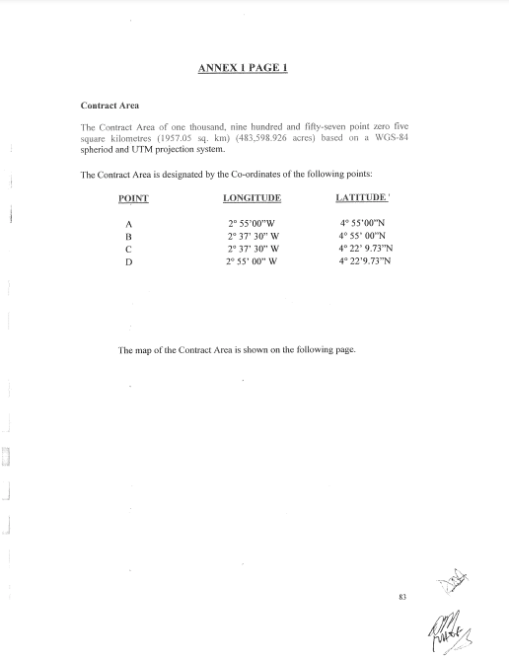
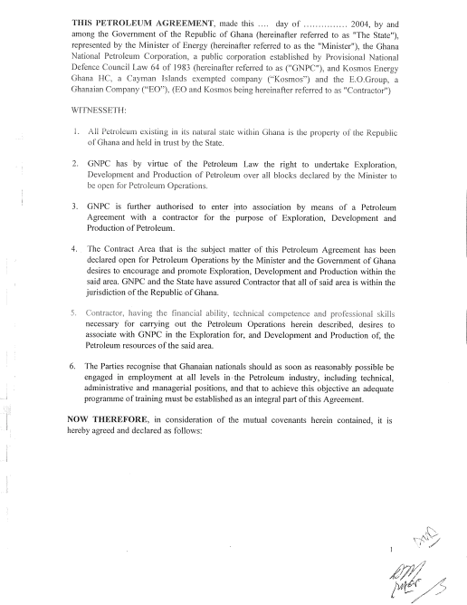
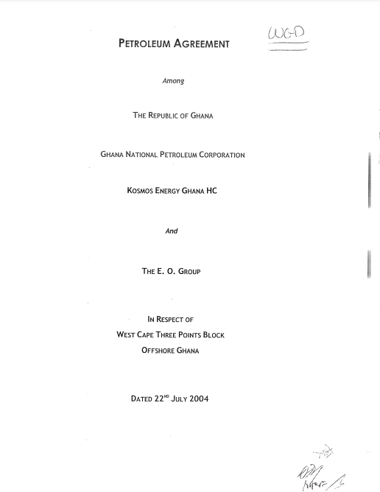
Contract
KEY CONCEPTS
Countries are required to disclose contracts/licenses that are granted, entered into, or amended from 1 January 2021.
Contract: The full text of any annexe, addendum or rider which establishes the details relevant to the exploitation rights.

Slide 9
Contract
KEY CONCEPTS
Where there are no clear rules, MSG should agree what are considered annexes, addenda or riders.
Consider documents that include information on:
  Sales agreements; fiscal terms; infrastructure and barter agreements; social and environmental expenditures and impacts

Slide 10
Annexes
KEY CONCEPTS
Follow national rules for what constitutes annexes.
If there are no rules, MSG should agree on what constitutes an annexe.
Notes:
Scope of the requirement:
Requirement 2.4.d– contracts/2.4a- licenses
The full text of any contract, concession, production-sharing agreement or other agreement granted by, or entered into by, the government which provides the terms attached to the exploitation of oil gas and mineral resources.
full annex, addendum or rider
full text of any alteration

Slide 11

Confidentiality provisions
KEY CONCEPTS
Redaction and contract summaries are NOT an option
Contract parties could sign waivers of confidentiality
MSG could:
  Examine confidentiality claims (full contract or specific provisions)
  Document outcomes
  Establish action plans to overcome legal obstacles

Slide 12
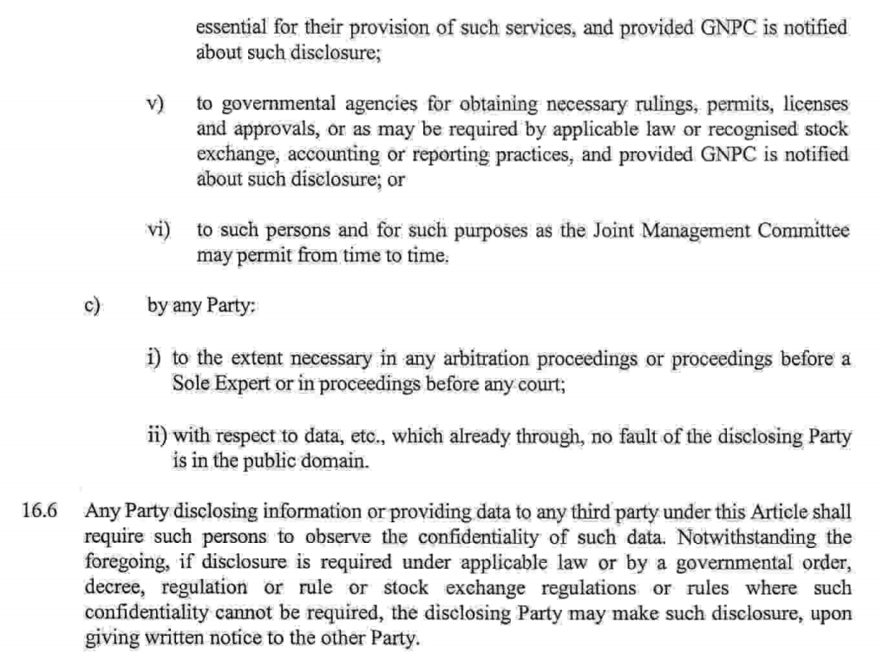
KEY CONCEPTS
EXAMPLE
Ghana
Contracts may include guidance on how to disclose information

Slide 13

Amendments
KEY CONCEPTS
If amendments occur after 1 January 2021:
Full disclosure of original contract, including previous amendment, is mandatory.
Parties may restate inactive terms in updated version of the contract.
If risks of disclosing provisions that were confidential before 1 January 2021, MSGs can request confidentiality waivers from contract parties.
Notes:
Issue:
Does amendment trigger disclosure even of contracts executed before 1 January 2021?
Amendment triggers disclosure of contracts even if they are executed before 1 January 2021.
Full disclosure of the original contract that is being amended is required, including previous amendments.
If there are concerns about disclosing terms from previous versions of the contract that are no longer active, the parties could opt to restate the terms in an updated version of the contract
If disclosure of full contracts would entail disclosure of confidential provisions entered into before 1 January 2021, MSGs could ask the parties to the contract to execute waivers on confidentiality

Slide 14

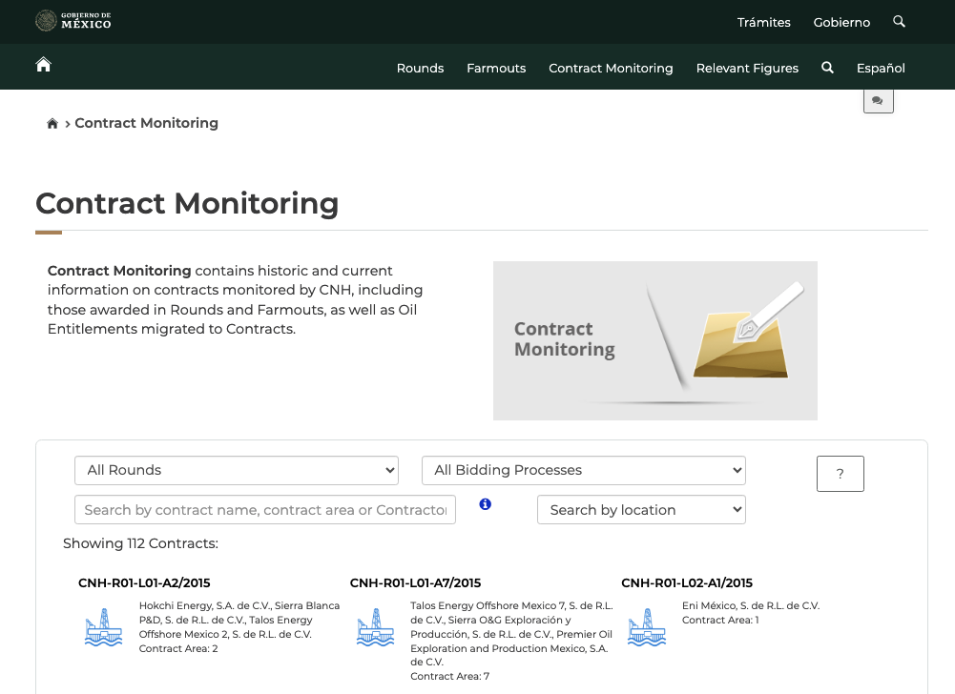
KEY CONCEPTS
EXAMPLE
Mexico
Government publishes oil and gas contracts via portal hosted by the National Hydrocarbons Commission (CNH).
Explains regulatory processes around contracting and allows users to see amendments made to contracts over time.

Slide 15
Challenges in implementation
KEY CONCEPTS
Constraints in capacity and infrastructure ​
Lack of political will ​
Lack of coordination among government ​ministries and agencies
Accessibility of portals
Notes:
The challenges above are from the findings of the 2022. The challenges remained the same based on the 2020 stocktake findings
2024 stocktake to commence in June

Slide 16
Role play: Arguing for contract transparency
KEY CONCEPTS
Contracts contain commercially sensitive information that could cause competitive harm if disclosed
Confidentiality clauses contained within contracts do not permit contract transparency
Contract transparency will scare off investors
Contracts are too complex for the general public to understand
Notes:
ARGUING FOR CONTRACT TRANSPARENCY
The most common arguments against contract transparency, as demonstrated below, are
fairly easy to rebut.
Argument: Contracts contain commercially sensitive information that could cause
competitive harm if disclosed.
Rebuttal: Petroleum contracts are unlikely to contain the kinds of information about a
project that is commercially sensitive. This stands to reason. After all, it is common for
petroleum contracts to be signed by consortiums of companies and for the companies
within those consortiums to change over time, meaning that companies go into contracts
knowing that competitors will have access. Given this reality, it is highly unlikely that any
company would risk writing trade secrets into any contract.
Argument: Confidentiality clauses contained within contracts do not permit contract
transparency.
Rebuttal: In most cases, legislation and/or mutual consent can generally supersede
confidentiality clauses. Further, confidentiality clauses often make room for exceptions
when all parties to the contract agree. In many countries extractive industry confidentiality
clauses in contracts are not written a way that expressly forbid contract disclosure. However,
it is impossible to know for certain without accessing the contracts.
Argument: Contract transparency will scare off investors.
Rebuttal: There is no evidence that a company’s or a country’s commercial position has
been affected due to contracts being disclosed. In fact, countries such as Liberia and Ghana
have received significant investment as they have disclosed contracts, while Mexico has
put contract transparency at the center of successful efforts to attract private capital to the
petroleum sector post-2013.
Argument: Contracts are too complex for the general public to understand.
Rebuttal: There is a wealth of free educational tools available to educate policy-makers as
well as civil society, the general public and media. While there is clearly a need for additional
public education on how to analyze and monitor extractive industry contracts, a growing
amount of experience shows that disclosure improves public dialogue and provides a strong
basis for improving citizen understanding

Slide 17
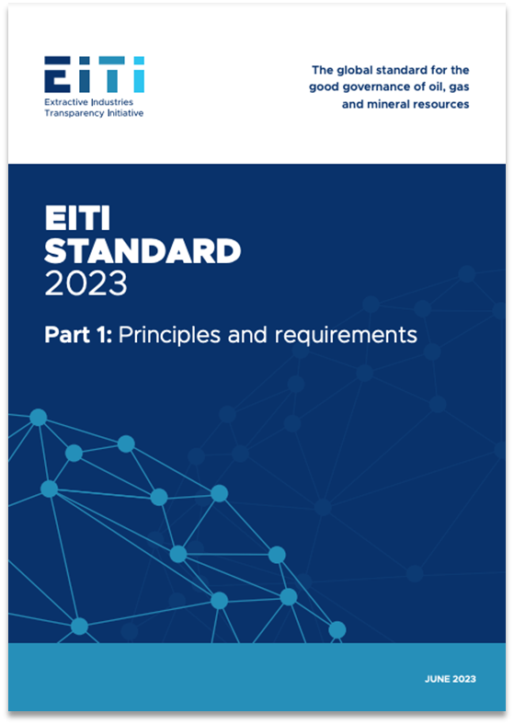
2023 EITI STANDARD
Summary of key changes on contract transparency

Slide 18


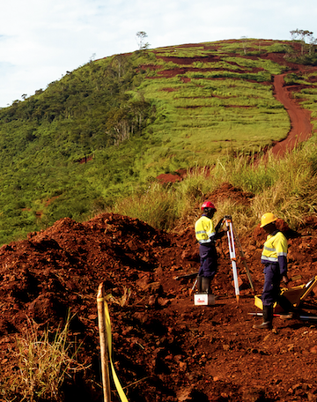

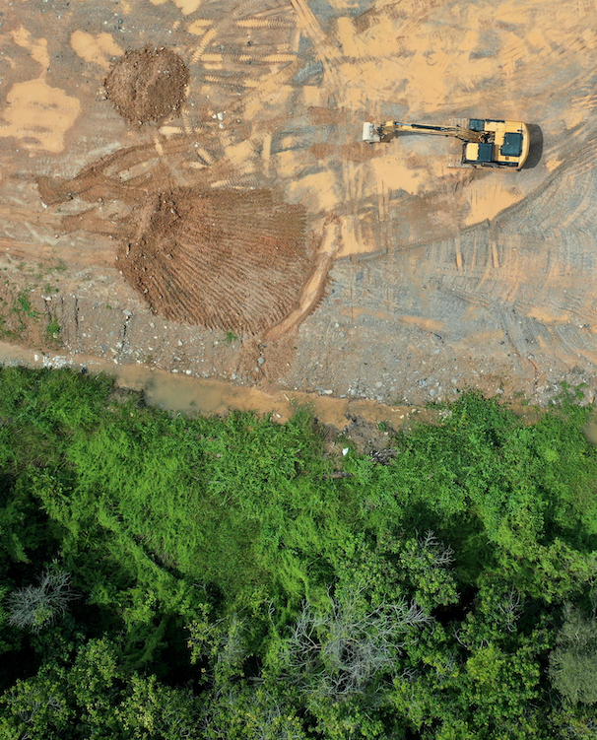
Key aspects
DISCLOSURE OF CONTRACTS & RELATED AGREEMENTS
DISCLOSURE OF SALES AGREEMENTS
EXPLORATION CONTRACTS
INFRASTRUCTURE AND BARTER AGREEMENTS
SOCIAL AND ENVIRONMENTAL PAYMENTS

Slide 19

CONTRACTS
Requirement 4.2 (c)
Countries are encouraged to disclose the related sales agreements with buying companies

Slide 20
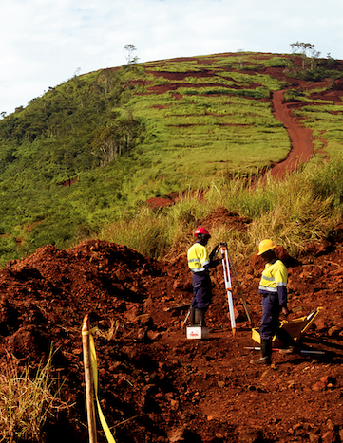
CONTRACTS
Requirement 2.4 (a)
Countries are encouraged to publicly disclose material exploration contracts
Notes:
Implementing countries are encouraged to publicly disclose any contracts and licenses that provide the terms attached to the exploitation of oil, gas and minerals, as well as material exploration contracts.

Slide 21
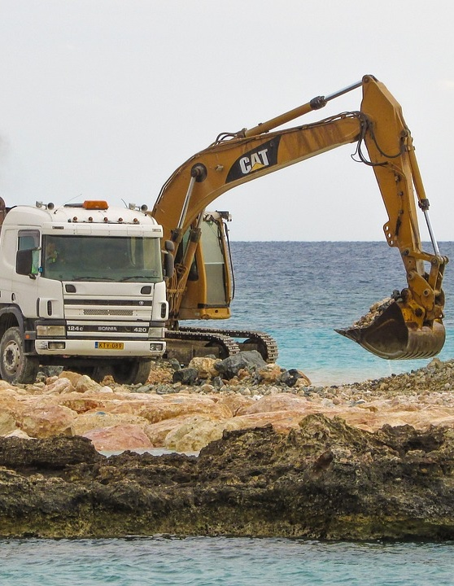
CONTRACTS
Requirement 4.3 (b)
Countries are encouraged to publish the underlying barter or infrastructure agreements, including resource-backed loan agreements

Slide 22
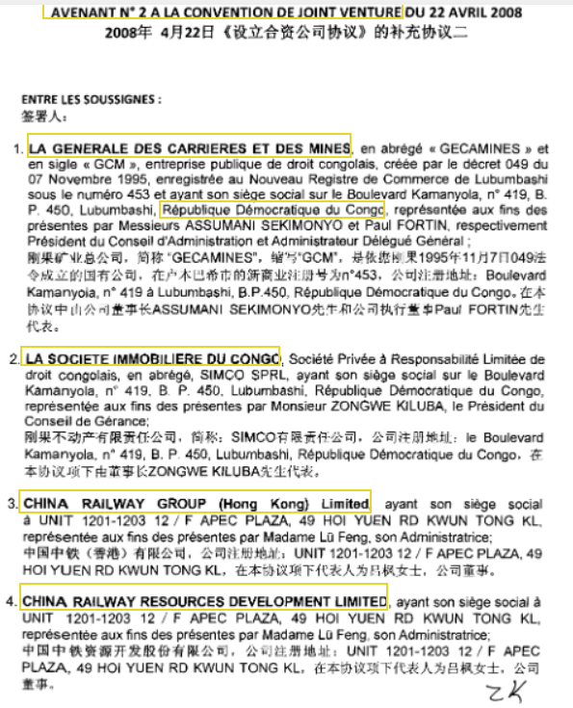

INFRASTRUCTURE AND BARTER AGREEMENTS
EXAMPLE
Democratic Republic of the Congo
Disclosed, assessed and renegotiated the Sicomines infrastructure agreement with Chinese investors

Slide 23

INFRASTRUCTURE AND BARTER AGREEMENTS
EXAMPLE
Ghana
Ghana's oil revenue relies on contracts with Litasco and Chinese state-owned Unipec Asia; latter linked to Ghana’s 3 bn loan agreement from China Development Bank.
Discloses GNPC’s sales agreement with Unipec Asia.
Unipec Asia commits to purchasing five cargoes yearly for 15.5 years from Ghana's Jubilee field.
Notes:
Most of Ghana’s oil revenue comes from two long-term sales contracts with the Russian trader Litasco and the Chinese state-owned company Unipec Asia, with the latter tied to the government’s loan from China Development Bank.
Ghana’s national oil company, GNPC, has a long-term sales agreement with Unipec Asia signed as part of the 2011 umbrella agreement of a USD 3 billion loan between the Government of Ghana and China Development Bank.
Under this long-term sales agreement, which came into effect in February 2012, Unipec Asia, a trading subsidiary of Chinese state-owned Sinopec Group, has agreed to the purchase of five cargos per calendar year from the Jubilee field for 15.5 years.

Slide 24
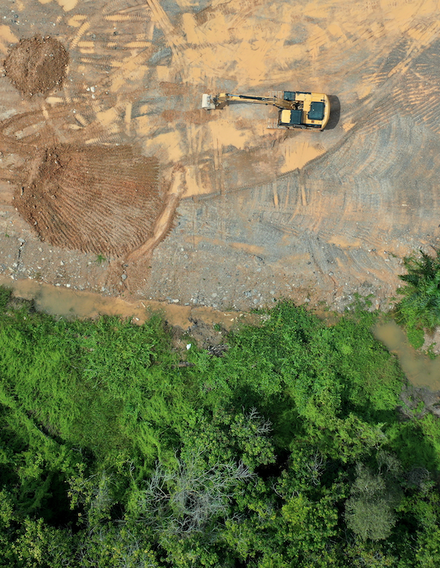
SOCIAL AND ENVIRONMENTAL PAYMENTS
Requirement 6.1 (a)
Countries are required to disclose the contracts that mandate social expenditures by companies whether the expenditures are in cash or in-kind.

Slide 25
SOCIAL AND ENVIRONMENTAL PAYMENTS
Requirement 6.1 (a-b)
Countries are expected to disclose:
Contracts, and any other documents required by law, that describe the level and allocation of material mandatory social expenditures
Contracts mandating environmental payments

Slide 26

SOCIAL AND ENVIRONMENTAL PAYMENTS
EXAMPLE
Papua New Guinea
PNG LNG Community Development Support Management Plan
Covers all community development support activities undertaken by the project such construction of library and sanitation facilities, and capacity building for women

Slide 27
Resources
Guidance Note on contracts (EITI Requirement 2.4)
Guidance Note on contract and license allocations (EITI Requirement 2.2)
Guidance Note on resource-backed loans (EITI Requirement 4.2)
Guidance Note on infrastructure and barter agreements (EITI Requirement 4.3)
ICMM & EITI (2023), The critical mineral rush: Why is contract transparency so important?
Study on disclosing exploitation terms under Requirement 2.4: Identifying agreements, plans and assessments (to be published)
Primer on the role of contract transparency in the energy transition (to be published)

Slide 28
Questions?

Slide 29
E-MAIL secretariat@eiti.org PHONE +47 22 20 08 00
ADDRESS EITI International Secretariat, Rådhusgata 26, 0151 Oslo, Norway

