Slide 1
2023 EITI Standard: Key changes
Beneficial ownership disclosure

Slide 2

Why is beneficial ownership transparency important?
REFLECTION
Notes:
Ask the audience to respond to this questions and summarise their replies.

Slide 3

Why is beneficial ownership transparency important?
REFLECTION
Anonymous companies can facilitate money laundering and corruption
Knowing who owns and controls extractive companies is key to address corruption risks and conflicts of interest
Notes:
The abuse of anonymous companies remains the getaway vehicle for the corrupt. They enable wrongdoers to hide behind a chain of companies registered in multiple jurisdictions. Protecting anonymity can deter investment and make it harder to curb corruption. It is estimated that developing countries have lost USD 1 trillion a year since 2011 as a result of corrupt or illegal deals, many of which involve anonymous companies.
Knowing who has the rights to extract oil, gas and minerals is key to addressing risks of corruption or conflict of interest.
Multi-stakeholder groups are required to consider issues related to extractive sector governance – including issues related to corruption – to place more focus on ensuring that EITI implementation strengthens anti-corruption efforts and addresses other nationally relevant governance issues.

Slide 4

For governments & citizens
REFLECTION
Enhance the recovery of stolen assets
Preserve mining licensing system integrity by preventing corruption associated to political connections
Preserve public procurement integrity by uncovering conflicts of interest
Monitor participation of local businesses in mining supply
Improve investment climate
Notes:
Provides an additional tool for the recovery of stolen assets.
Restores the integrity of the mining licensing system and ensures the absence of political connections that promote corruption.
Increases integrity of public procurement by detecting conflicts of interest.
Enables effective monitor progress towards increased participation of local businesses in the supply of goods and services to the mining sector and participation of citizens in mining activities.
Improves countries’ standing as an attractive investment destination.

Slide 5

For companies
REFLECTION
Create clean and fair operating and investment climate
Enhance social license to operate
Support due diligence on suppliers and business partners
Promote and protect reputation by committing to transparent business practices

Slide 6


2023 EITI Standard
New provisions:
Enhance opportunities for countries and companies to identify and address corruption risks
Strengthened provisions on beneficial ownership disclosure
Notes:
The EITI Standard has evolved to respond to stakeholder needs and a changing global context.
Now in its fourth edition, the 2023 EITI Standard now includes several new and refined provisions that enable countries to respond to the most pressing challenges that concern natural resource governance today.
Since 2020, the EITI has been strengthening its work on anti-corruption, recognising the unique opportunity for EITI implementation to address corruption and governance risks in the natural resource sector.
For the first time, the 2023 EITI Standard explicitly reflects anti-corruption in the objectives and text of several EITI Requirements.
It includes provisions to help EITI implementing countries identify areas across the extractive sector value chain that are vulnerable to corruption, without imposing burdensome reporting requirements.
As part of strengthening aspects of the standard related to anti-corruption, there are some key changes on beneficial ownership

Slide 7
BOT across the value chain
The EITI Standard covers
Natural resources
Contracts & licenses
Production
Revenue collection
Revenue allocation
Social & economic spending
Public benefit
Establishes integrity checks for license/contract awards and transfers
Enhances government oversight of operators/projects
Reduces corruption risks in supply chain procurement
Helps expose shell companies and schemes used for tax evasion/money laundering
Deters conflict of interest in revenue management
Exposes revenue diversions through shell companies
Detects conflict of interest in procurement processes
Enhances reputation and credibility for investors in public projects
Notes:
Contracts and licenses: Prevents conflict of interest /Ensures compliance with anti-corruption provisions/ Detects anomalies and license transfers/ Reveals track record and past conduct of license applicants
Production: Supports government oversight of operators and project participants / Improves due diligence / Reduces corruption in procurement /
Revenue collection: Exposes shell companies and schemes used for tax evasion / Curbs money laundering by revealing ultimate beneficiaries / Attracts investment by providing necessary data for investors and analysts
Revenue allocation: Prevents conflict of interest in management of resource funds / Reveals attempts to divert revenues through shell companies / Increases oversight of joint venture partnerships with state owned enterprises
Social and economic spending: Detects conflict of interest in government procurement processes / Increases competition and attracts responsible investors in public projects /Enables law enforcement to identify and pursue criminal activity /Improves revenue collection and increases domestic resources available to citizen services

Slide 8
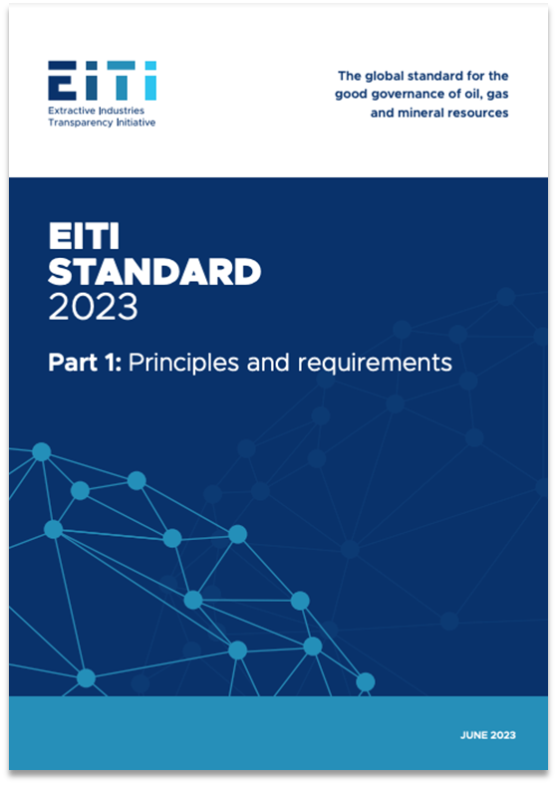
2023 EITI STANDARD
Summary of key changes on beneficial ownership

Slide 9




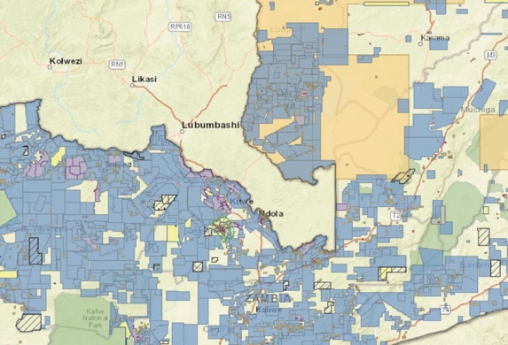


Key aspects
REPORTING THRESHOLDS
POLITICALLY EXPOSED PERSONS
STATE-OWNED ENTERPRISES
LEGAL OWNERSHIP & STRUCTURES
LICENSING
COMPANY POLICIES & PRACTICES
COMPREHENSIVENESS & RELIABILITY
Notes:
There are seven key changes in the 2023 Standard that relate to beneficial ownership
Reporting thresholds
PEPs
SOEs
Legal ownership and structures
Licensing
Company policies and practices
And comprehensiveness and reliability of stock exchange filings

Slide 10
KEY ASPECT
Ownership threshold for beneficial ownership reporting
Notes:
First aspect – ownership thresholds.
For the most common forms of ownership and control – namely, direct or indirect possession of ownership shares, voting rights, and right to income – most jurisdictions establish a threshold for disclosure requirements, expressed as a percentage of total ownership or control.
When establishing the definition of beneficial ownership, jurisdictions specify the minimum stake an individual needs to own or control in a company, such as possession of ownership shares or voting rights. The lower the threshold, the easier it is to identify hidden interests.
However, there is no one-size-fits-all level for thresholds since different percentages will be appropriate in line with the different policy aims that governments pursue via BOT. Similarly, certain economies or industry sectors that are associated with higher risks of financial crime should apply more stringent thresholds.
Whilst thresholds can always be exploited by individuals seeking to avoid disclosure requirements by limiting their ownership stakes to just below the level stipulated in law, having low thresholds makes this more difficult. Lower thresholds for reporting the beneficial owners of oil, gas and mining companies enable the public to have a more comprehensive view of who benefits from natural resources.

Slide 11
OWNERSHIP THRESHOLDS FOR REPORTING
Requirement 2.5(f)(i)
Implementing countries are encouraged to adopt an ownership threshold of 10% or lower for beneficial ownership reporting.
Notes:
The EITI Standard now encourages countries to adopt an ownership threshold of 10% or lower.
This means that any individual who directly or indirectly holds this or a higher percentage of shares of a company will be disclosed as a beneficial owner. This ensures that most or all ownership interests are disclosed, leaving no room for hidden interests.
This makes the EITI the only Standard clearly recommending a threshold. FATF does not recommend a specific threshold level, but mentions a maximum 25% figure as recommended, in the context of examples to illustrate how thresholds would work.
While early adopters like the UK and Ukraine established a 25% threshold in 2015, and the European Union’s AMLD4 did the same that year, more recent legislation across jurisdictions has set lower thresholds.
Now, more than 20 EITI countries have embraced a threshold of 10% or less, including Argentina (1 share or above), Colombia (5%), Nigeria (5%) and Senegal (2%).
Several countries have also adopted lower thresholds specifically for high-risk sectors such as the extractives, including Armenia (10% for mining sector, versus 20% for other sectors), Ghana (5% for locally registered extractive sector companies, versus 20% for low-risk sectors) and Liberia (5% for mining, oil, gas and agriculture, versus 10% for the forestry sector).
Still, many countries have yet to follow suit.

Slide 12
Rationale
OWNERSHIP THRESHOLDS FOR REPORTING
Extractive sector has high corruption risks
Low reporting thresholds can clarify ownership (e.g. small stake in large company)
Enables public oversight of who benefits from natural resources
Notes:
When setting threshold levels, governments should start by examining the policy goals behind their drive to create BO registers. These can include tackling corruption, money laundering, terrorism financing, and tax evasion, or supporting economic activity by lowering the chance of fraud and the cost of due diligence. A low threshold is necessary to capture data on the relevant beneficial owners that enable governments to meet the majority of these policy goals.
When setting thresholds, implementers should adopt a risk-based approach (RBA) to most effectively meet their specific policy goals. High thresholds leave a disclosure regime vulnerable to loopholes, whilst low thresholds enable authorities to capture more data on those with relationships of ownership or control over corporate vehicles.
The extractives sector, being a high risk sector in most EITI implementing countries, should therefore have lower thresholds for reporting the beneficial owners of oil, gas and mining companies. This enables the public to have a more comprehensive view of who benefits from natural resources.
Armenia, for instance, moved from a 20% threshold for BO in its 2008 AML law to a 10% level for its 2019 mining sector disclosures. Similarly, Liberia adopted a 5% threshold for mining, oil, gas, and agriculture, versus a higher 10% threshold for the forestry sector. Ghana has adopted a 0% threshold for all locally registered extractive sector companies. Foreign extractive companies operating in Ghana are subject to a 5% disclosure threshold.
Sector-specific thresholds are easier to implement in regulated industries or other situations where authorities know which companies are operating in a given sector, and therefore also which companies are expected to declare at a given threshold.

Slide 13
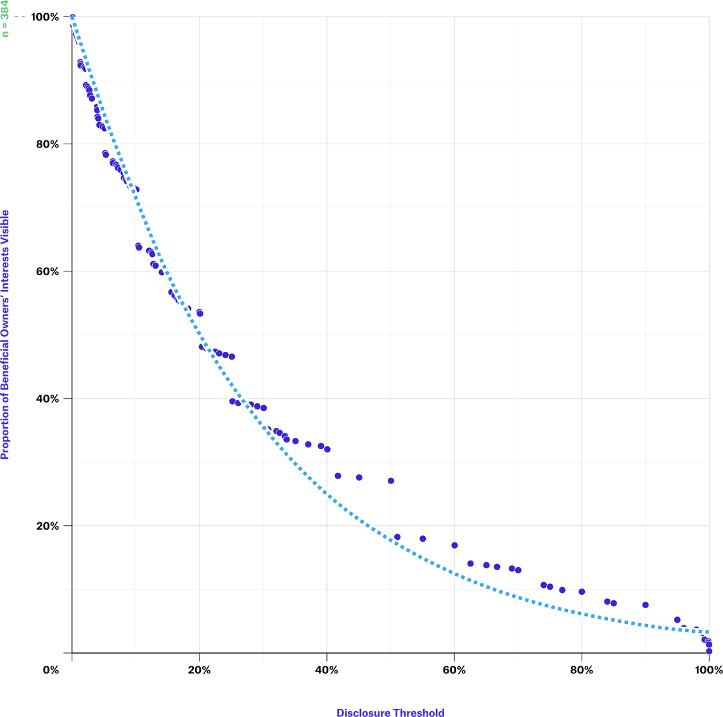
OWNERSHIP THRESHOLDS FOR REPORTING
CASE STUDY
Nigeria
Visibility of beneficial owners at different threshold levels in Nigeria's extractives sector
Proportion of beneficial owners’ interests visible
Disclosure threshold
SOURCE: NEITI & OPEN OWNERSHIP
Notes:
Setting low thresholds ensures that a greater number of beneficial owners are disclosed to authorities.
Examination of the data from Nigeria’s extractive industry disclosures in this figure demonstrates the extent to which different thresholds can alter the number of interests disclosed by beneficial owners.
If Nigeria had applied a 20% threshold for its extractive industries disclosure requirements, rather than effectively having no threshold level, then the number of reported interests would have halved. This would very likely have had detrimental effects on the policy aims of helping to prevent or investigate corruption cases linked to the sector.

Slide 14

KEY ASPECT
Reporting obligations for politically exposed persons (PEPs)
Notes:
Second aspect – reporting obligations for politically exposed persons or PEPs.

Slide 15
REPORTING OBLIGATIONS FOR PEPS
Requirement 2.5(c)
Implementing countries are required to request companies to disclose any politically exposed persons who directly or indirectly hold an interest in a company, regardless of their level of ownership.
Notes:
The 2023 EITI Standard strengthened the requirement for disclosure of PEPs who directly or indirectly hold an interest in a company, by requiring full disclosure of PEPs regardless of their level of ownership.

Slide 16
Rationale
REPORTING OBLIGATIONS FOR PEPS
It is widely recognised that the influence and power PEPs derive from their positions can be abused for the purpose of corruption, bribery, and money laundering.
These disclosures are paramount for identifying conflicts of interest.
A lack of transparency on PEPs and their assets – specifically those held in the extractive sector – can pose high corruption risks, especially when PEPs are involved in the award of natural resource concessions.
Notes:
These disclosures are important for identifying conflicts of interest.
Conversely, a lack of transparency on PEPs and their assets – specifically those held in the extractive sector – can pose high corruption risks, especially when PEPs are involved in the award of natural resource concessions.
Initiatives like “Joining the dots” demonstrate the value of using this information.

Slide 17

REPORTING OBLIGATIONS FOR PEPS
CASE STUDY
Armenia & Ghana
Define PEPs and have reporting obligations
Establish ownership thresholds for PEPs:
  Armenia 0%
  Ghana 0% local PEPs, 5% high risk & foreign PEPs
Notes:
Countries like Armenia, Ghana or the Kyrgyz Republic require beneficial owners that are PEPs to disclose their ownership or control irrespective of the size of the stake.

Slide 18

KEY ASPECT
Ownership and control of state-owned enterprises and suppliers
Notes:
Third aspect – ownership and control of state-owned enterprises and their suppliers.
SOEs in the extractive sector play an important role in the production and sale of natural resources and may, thereby, generate significant revenue for the state.
Not having visibility of how SOEs are owned and controlled would constitute a considerable weakness that could undermine the specific aims of beneficial ownership transparency reforms.
The specific risks of opaque ownership and control of SOEs include:
A lack of visibility of the transfer of assets between private and public sectors;
The misuse of SOE resources;
Not understanding the impact of SOEs on the economy;
And not understanding the impact of any cross-border activity undertaken by SOEs.

Slide 19

OWNERSHIP & CONTROL OF SOES
Requirement 2.5(e)(v)
SOEs are required to disclose:
Name of the state(s) owning or controlling the SOE
Level of ownership
Details about how ownership or control is exerted
If the SOE is not fully owned by the state, BO information should be disclosed in accordance with Req. 2.5(c).
Notes:
Under the 2023 Standard, SOEs are required to disclose:
Name of the state(s) owning or controlling the SOE
Level of ownership
Details about how ownership or control is exerted
In any declaration by an SOE, it is recommended to capture information about the state or state agency involved – this is in addition to the usual information required about natural persons, to be able to comprehensively understand their ownership and control. In this context, only declaring the state ownership of an SOE is insufficient, and more focus should be put on those in control and the benefits that may arise from their positions of stewardship.

Slide 20
OWNERSHIP & CONTROL OF SOES
Requirement 2.6(e)
Where feasible, SOEs are encouraged to disclose the identity and beneficial ownership of their agents or intermediaries, suppliers or contractors for material transactions.
Notes:
Where feasible, SOEs are encouraged to disclose the identity and beneficial ownership of their agents or intermediaries, suppliers or contractors for material transactions.

Slide 21
Rationale
OWNERSHIP & CONTROL OF SOES
Ensure business dealings are conducted ethically and fairly
Assessment of risks linked to intermediaries, contractors, and suppliers
Enhance investor confidence
Notes:
Unlike in the case of an ordinary business, for SOEs, the people whom the state represents have no direct relationship to the entity – neither in regard to the usual benefit of profit, nor in control over operations. However, SOEs deploy public funds. It is therefore taxpayer money that has been invested and is at risk, as well as, potentially, the state’s natural resources, reinforcing the need for transparency to enable accountability and oversight.
SOEs often have complex corporate structures – sometimes spread across multiple jurisdictions – which intertwine with governments in diverse ways via direct or indirect ownership stakes or controlling interests.
To prevent corruption and bribery, it is essential to identify the ultimate owners of companies engaged in transactions with state-owned enterprises (SOEs). This ensures that business dealings are conducted in an ethical and fair manner. The disclosure of beneficial ownership information enables the assessment of risks linked to intermediaries, contractors, and suppliers.
Clear and accessible information about SOEs ownership and control enhances investor confidence.

Slide 22
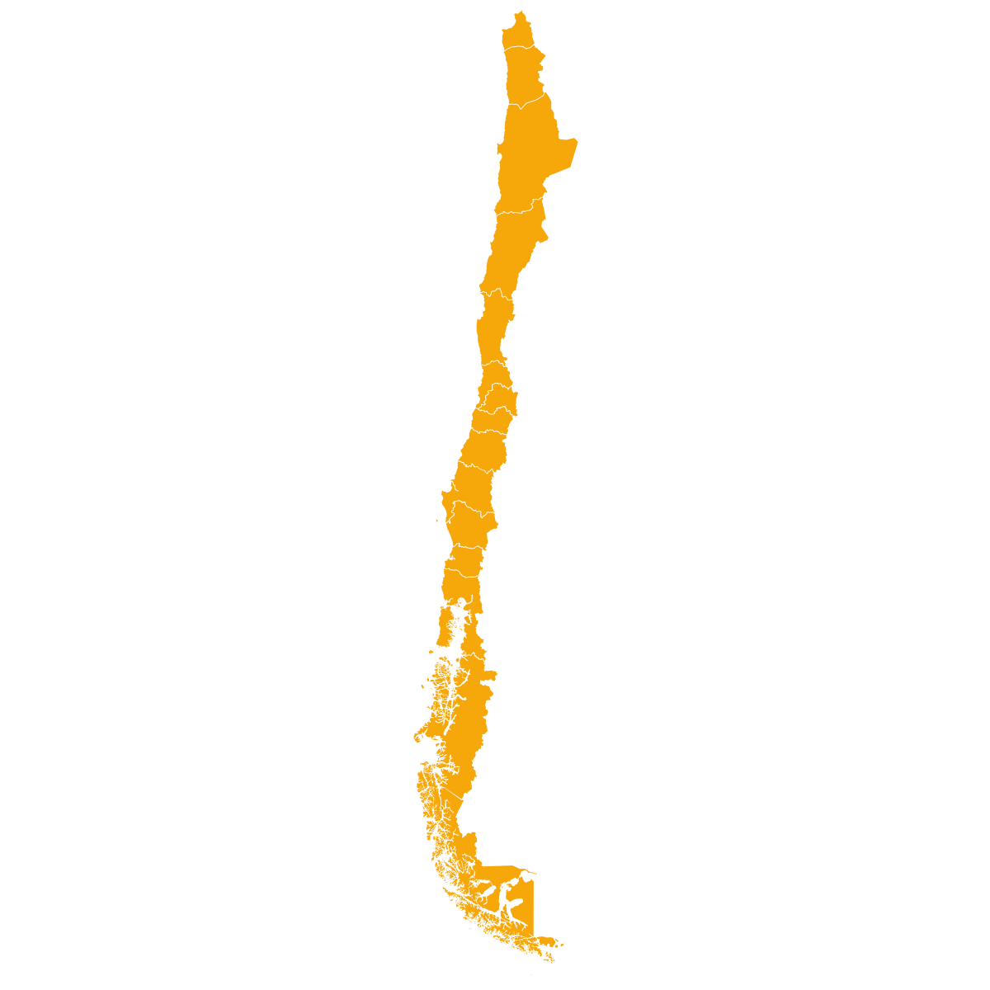
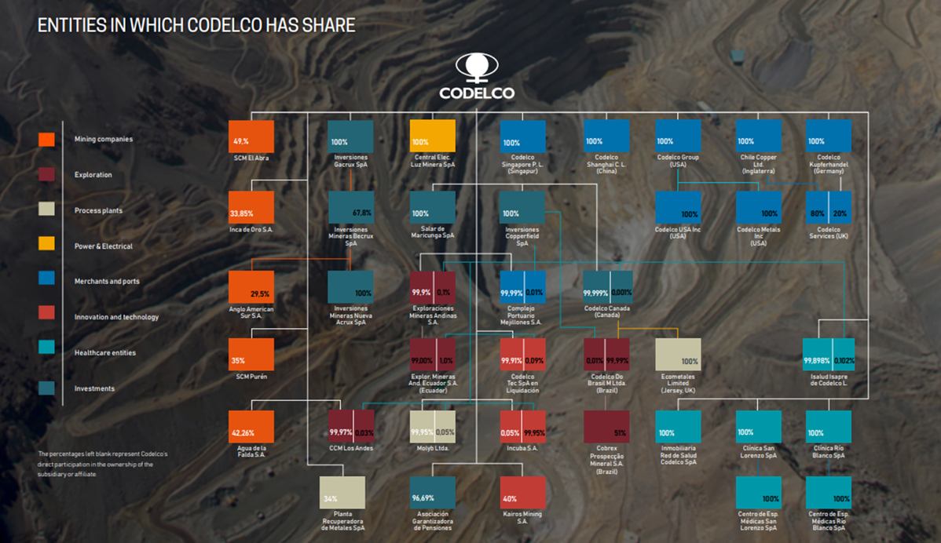
OWNERSHIP & CONTROL OF SOES
CASE STUDY
Codelco, Chile
Details about ownership and control disclosed on website
Discloses information about subsidiaries and affiliates, including % of ownership in its 2022 Comprehensive Report
Notes:
Top copper mining company, 100% owned by the Chilean state. Codelco is part of ICMM and therefore supports the EITI.
Codelco publishes information about its subsidiary companies on its website https://www.codelco.com/transparencia/filiales.
In addition, on pages 215 and 216 of the "Integrated Report 2022" data on exploration activities in Brazil are reported.
https://www.codelco.com/prontus_codelco/site/docs/20230405/20230405113753/memoria2022.pdf.
Codelco publishes information on financial results on its website
https://www.codelco.com/transparencia/estados-financieros-y-memorias/estados-financieros-consolidados
Expect 6: Shareholders meeting website:
https://www.codelco.com/transparencia/junta-de-accionistas / The company discloses its corporate governance structure on its 2020 Sustainability Report, page 16-20. Codelco's Corporate Governance Law establishes as an operating principle that it corresponds to the President of the Republic to exercise the powers and functions of the shareholder and of the shareholders' meeting (role of "owner"). https://www.codelco.com/transparencia/junta-de-accionistas
Another example: PT Pertamina (https://www.pertamina.com/en/our-shareholder)
*OE SOE Policy Brief EN.pdf (eiti.org)

Slide 23

KEY ASPECT
Legal ownership & ownership structures
Notes:
Fourth aspect – legal ownership and ownership structures.

Slide 24
LEGAL OWNERSHIP & OWNERSHIP STRUCTURES
Requirement 2.5(g)
Implementing countries are required to disclose the legal owners of the corporate entity(ies) defined in Req. 2.5(c), including share of ownership.
Applies to corporate entities that apply for or hold a participating interest in an exploration or production oil, gas or mining license or contract.
Notes:
Implementing countries are required to disclose the legal owners of the corporate entity(ies) defined in Req. 2.5(c), including share of ownership.

Slide 25
LEGAL OWNERSHIP & OWNERSHIP STRUCTURES
Requirement 2.5(g)
Companies are encouraged to disclose their ownership structure, including the full chain of legal entities leading to the beneficial owner.
Applies to corporate entities that apply for or hold a participating interest in an exploration or production oil, gas or mining license or contract.
Notes:
Companies are also encouraged to disclose their ownership structure, including the full chain of legal entities leading to the beneficial owner.
Tab 4 c in the BO model declaration form provides a template for disclosing beneficial owners. The model declaration

Slide 26
Rationale
LEGAL OWNERSHIP & OWNERSHIP STRUCTURES
Knowing the ultimate beneficial owner is not enough to understand a company’s whole ownership structure.
Understanding legal owners and the ownership structure of company can help in providing a full picture of the company’s ownership chain.
Notes:
Knowing the ultimate beneficial owner is not enough to understand a company’s whole ownership structure.
Understanding legal owners and the ownership structure of company can help in providing a full picture of the company’s ownership chain.
This can help to map the entire scope of companies and relationships between individuals and legal entities that control, influence or own a company, which can inform investigations on conflicts of interest.

Slide 27
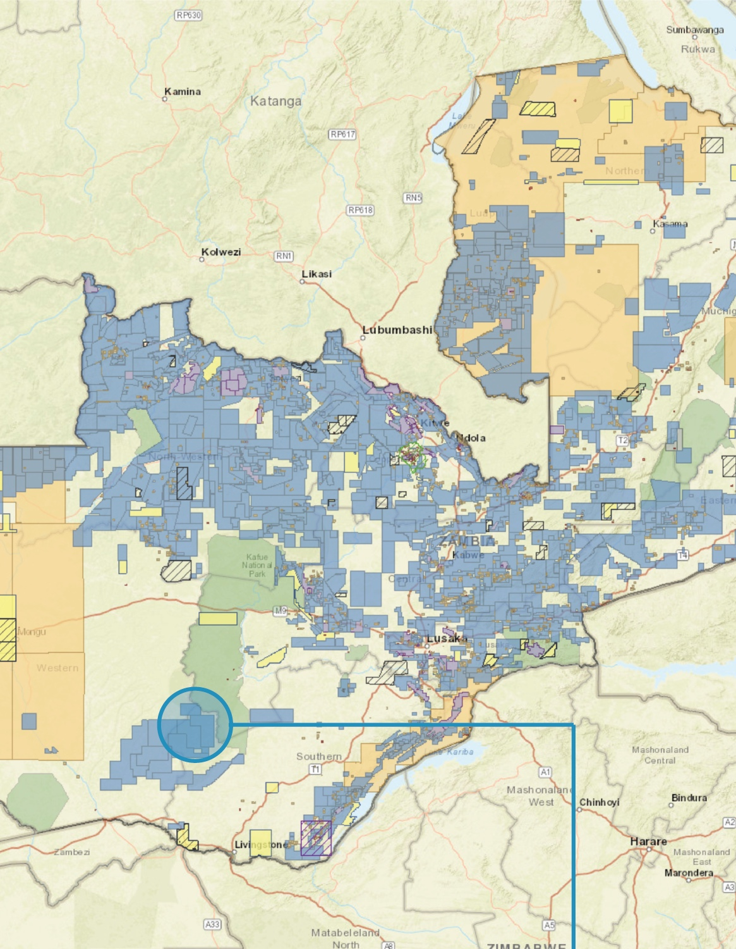
KEY ASPECT
License register, license applications and beneficial owners
Notes:
Fifth aspect – linking BO to license applications and registers.

Slide 28
LICENSE REGISTER, APPLICATIONS & BO
Requirement 2.2 (c)
Where licenses are awarded through a bidding process, the government is required to disclose the list of applicants, including their beneficial owners in accordance with Req. 2.5, and the bid criteria.
Notes:
Requirement 2.2 c now states that, where licenses are awarded through a bidding process, the government is required to disclose the list of applicants, including their beneficial owners in accordance with Req. 2.5, and the bid criteria.

Slide 29
LICENSE REGISTER, APPLICATIONS & BO
Requirement 2.3 (d)
Implementing countries are encouraged to link publicly available license registers to other government platforms that disclose or hold information in accordance with Req. 2.5 on the legal and beneficial owners of oil, gas and mining companies.
Notes:
In addition, implementing countries are encouraged to link publicly available license registers to legal and beneficial ownership registers or other government platforms that disclose or hold information in accordance with Requirement 2.5.

Slide 30
Rationale
LICENSE REGISTER, APPLICATIONS & BO
The 2023 EITI Standard reinforces the connection between licensing and beneficial ownership information, helping ensure that licenses are granted to transparent and accountable entities.
This linkage can help regulators analyse who is behind the legal entities applying for, holding or transferring licenses. It serves as a method for integrity screening.
Notes:
The 2023 EITI Standard reinforces the connection between licensing and beneficial ownership information, helping ensure that licenses are granted to transparent and accountable entities.
This linkage can help regulators analyse who is behind the legal entities applying for, holding or transferring licenses.

Slide 31

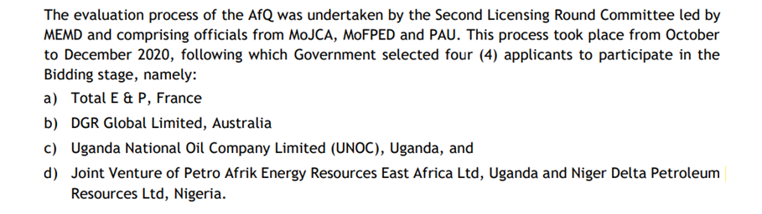
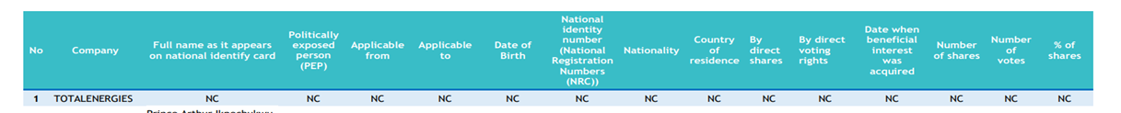
LICENSE REGISTER, APPLICATIONS & BO
CASE STUDY
UGANDA
Discloses legal ownership of applicants to a petroleum licensing round
Notes:
Although few jurisdictions actively link license and beneficial ownership information, the Opening Extractives programme, implemented by the EITI and Open Ownership, is supporting countries like Colombia, Ghana, Indonesia and Zambia to ensure that beneficial ownership data is actively used for license screening.
In this case Uganda has disclosed through the EITI report a partial list of applicants to the second licensing bidding round. Some of the applicants are material companies already required to provided BO information. However, Uganda did disclose only those a list of prequalified applicants. It would be necessary for Uganda to disclose the full list of applicants (which were 6 and not 4) and the respective BO information.
Countries like Armenia, who discloses BO information on all their mining companies, are also a good example.
Other examples in which BO is required (as stipulated by law) for bidding rounds/licensing rounds but not disclosed to the public: Colombia/Mexico

Slide 32


KEY ASPECT
Company policies and practices on beneficial ownership
Notes:
Sixth aspect – Company policies and practices on beneficial ownership.

Slide 33
COMPANY POLICY AND PRACTICE
Requirement 1.2 (b)
Reporting companies and SOEs are expected to publish an anti-corruption policy including their use of beneficial ownership data.
Companies participating in MSGs are expected to engage in rigorous due diligence processes.
Notes:
The EITI Standard introduces new requirements that shed light on companies’ safeguards against corruption. All reporting companies, including state-owned enterprises, are now expected to publish an anti-corruption policy that sets out how they manage corruption risks, including their use of beneficial ownership data.
Additionally, companies that participate in multi-stakeholder groups are expected to engage in rigorous due diligence processes to strengthen the integrity of the EITI process.
State-owned enterprises are encouraged to disclose the identity of the beneficial owners of their agents or intermediaries, suppliers or contractors, where feasible.
These disclosures help to uncover connections to politically exposed persons (PEPs) and other conflicts of interest.

Slide 34
Rationale
COMPANY POLICY AND PRACTICE
Maintain a level playing field
Formalise anti-corruption policy and demonstrate use of BO data for due diligence
Alignment with Expectations for EITI supporting companies
Notes:
In line with what was mentioned at the beginning, this helps to maintain a level playing field, to formalise anti-corruption policies and demonstrate use of BO data for due diligence.
This also ensures that there is a clear alignment with the EITI’s Expectations for EITI supporting companies
Most companies already have such policies, so reporting is straightforward.
EITI requires documentation of policies and practices

Slide 35

COMPANY POLICY & PRACTICE
CASE STUDY
Auxico Resources Canada
Anti-corruption and bribery policy establishes due diligence provisions and sets out red flags:
Shell companies & entities owned or controlled by government officials, their relatives or associates
Reluctance or refusal to disclose ownership
Third party requests that identity not be disclosed
SOURCE: AUXICO RESOURCES CANADA INC., “GOVERNANCE DOCUMENTS”
Notes:
Red flags:
“shell companies, and entities owned or controlled by Government Officials or their relatives or associates”;
“reluctance or refusal to disclose ownership”;
“family ties of a third party with a Government Official”;
“third party requests that identity not be disclosed” (p. 26-27).
Due diligence measures include:
“background checks including qualifications, financial background, government and political ties, number and reputation of clientele, reputation in community, criminal record checks and possible associations with criminal, terrorist or other proscribed persons or groups […]
"If the background check reveals problematic information, Auxico will not, in the absence of extenuating circumstances, enter into an agreement with that third party.”

Slide 36


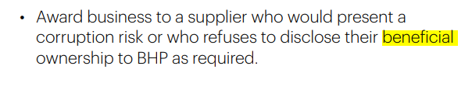
COMPANY POLICY & PRACTICE
CASE STUDY
BHP
Code of conduct set outs guidelines on requiring beneficial ownership information to manage corruption risks
SOURCE: BHP, “OUR CODE”
Notes:
We encourage our suppliers to be transparent on matters important to society, including on their beneficial ownership
Always:
-Understand the identity, role and interests of the person or business who you are dealing with (including the beneficial ownership of companies)
-Always ensure the supplier (including their beneficial owners): is reputable, competent and qualified to perform the work for which they are being hired; will operate safely and ethically; and that compensation sought is reasonable.
Never:
Deal with a party that refuses to disclose its true identity (including details of company beneficial ownership).
Award business to a supplier who would present a corruption risk or who refuses to disclose their beneficial ownership to BHP as required.

Slide 37
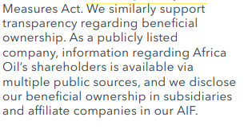
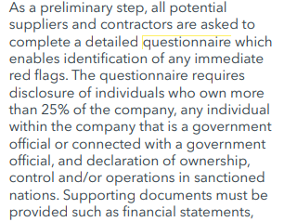
COMPANY POLICY & PRACTICE
CASE STUDY
Africa Oil Corp.
Africa Oil Corp's Supplier Due Diligence requires suppliers and contractors to complete a questionnaire disclosing BO exceeding 25% and PEPs.
SOURCE: AFRICA OIL CORP., “2022 SUSTAINABILITY REPORT”
Notes:
As a preliminary step, all potential suppliers and contractors are asked to complete a detailed questionnaire which enables identification of any immediate red flags. The questionnaire requires disclosure of individuals who own more than 25% of the company, any individual within the company that is a government official or connected with a government official, and declaration of ownership, control and/or operations in sanctioned nations. Supporting documents must be provided such as financial statements, incorporation documents and compliance policies and procedures. Should the third party have insufficient compliance documentation, we will refer them to our own policies. Additional scrutiny is given to contractors that would act as an agent on behalf of Africa Oil. Any identified risks at this stage are escalated to the Chief Financial Officer. The next step requires an internal representative to fill in another questionnaire providing additional information regarding Africa Oil’s knowledge of and relationship with the third party, including commercial terms. This aids our Corporate Counsel and Secretary to gauge the level of risk and potentially escalate any concerns to the Chief Financial Officer

Slide 38

KEY ASPECT
Reliability and comprehensiveness of ownership data for publicly listed companies
Notes:
Seventh aspect – Reliability and comprehensiveness of ownership data for publicly listed companies.

Slide 39
OWNERSHIP DATA OF PUBLICLY LISTED COMPANIES
Requirement 2.5 (f)(iii)
Publicly listed companies, including wholly-owned subsidiaries, are required to disclose the name of the stock exchange and include a link to the stock exchange filings where they are listed to facilitate public access to their beneficial ownership information.
Notes:
Publicly listed companies, including wholly-owned subsidiaries, are required to disclose the name of the stock exchange and include a link to the stock exchange filings where they are listed to facilitate public access to their beneficial ownership information.

Slide 40
OWNERSHIP DATA OF PUBLICLY LISTED COMPANIES
Requirement 2.5 (f)(iii)
The multi-stakeholder group is encouraged to review the comprehensiveness and reliability of ownership information disclosed in the stock exchange filings.
Notes:
EITI multi-stakeholder groups are also encouraged to review the comprehensiveness and reliability of ownership data disclosed in stock exchange filings.

Slide 41
Rationale
OWNERSHIP DATA OF PUBLICLY LISTED COMPANIES
Stock exchange filings are essential to the integrity of financial markets
Fosters investor confidence and fair and efficient capital allocation
Comprehensive disclosures help to prevent financial losses and promote a level playing field
Notes:
This is important because:
First of all, stock exchange filings are essential to the integrity of financial markets
Fosters investor confidence and fair and efficient capital allocation
Comprehensive disclosures help to prevent financial losses and promote a level playing field
Corrupt practices may involve false or misleading information in stock exchange fillings, insider trading manipulation of non-public information for personal gain.
On top of this, reviewing the comprehensiveness and reliability of ownership data disclosed in stock exchange filings can help address gaps in certain jurisdictions where publicly listed companies might take advantage of lax transparency requirements.

Slide 42
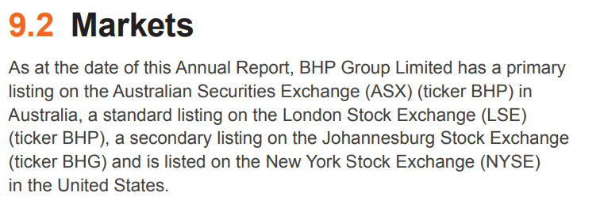
OWNERSHIP DATA OF PUBLICLY LISTED COMPANIES
CASE STUDY
BHP
Disseminates information through its website, where dedicated sections are allocated to each of its four stock exchange listings
SOURCE: BHP ANNUAL REPORT 2023
Notes:
https://www.pwc.com.au/legal/assets/listing-company-asx.pdf

Slide 43
OWNERSHIP DATA OF PUBLICLY LISTED COMPANIES
TOOL
Steps to check comprehensiveness/reliability
In assessing the robustness of the definition of ownership and control in an exchange's disclosure requirements, consideration should be given to whether companies must provide:
timely notification on the acquisition and disposal of significant voting rights;
notifications on the basis of aggregated holdings and interests used jointly via an agreement;
notifications of ownership and control arrangements via financial instruments that have a similar effect to owning shares or controlling votes;
notifications that contain information on the means through which major shareholding or voting rights are exercised (e.g. the chain of ownership);
notifications of interests held by company officers.
SOURCE: Open Ownership, 2020
Notes:
In assessing the robustness of the definition of ownership and control in an exchange's disclosure requirements, consideration should be given to whether companies must provide:
timely notification on the acquisition and disposal of significant voting rights;
notifications on the basis of aggregated holdings and interests used jointly via an agreement;
notifications of ownership and control arrangements via financial instruments that have a similar effect to owning shares or controlling votes;
notifications that contain information on the means through which major shareholding or voting rights are exercised (e.g. the chain of ownership);
notifications of interests held by company officers.
The future guidance note on Requirement 2.5 will shed more light on how to assess comprehensiveness and reliability.

Slide 44

Summary
Requirement 1.2:
Companies and SOEs to publish anti-corruption policy including their use of beneficial ownership data (expected)
Requirements 2.2 & 2.3:
Governments to disclose applicants’ beneficial owners (required)
Link publicly available license registers to other government platforms including those containing beneficial and legal owners (required)

Slide 45
Summary
Requirements 2.5 & 2.6:
≤ 10% ownership threshold (encouraged)
Report PEPs that are beneficial owners regardless of stake (required)
Review comprehensiveness and reliability of stock exchange filings (encouraged)
SOEs to report ownership and control (required), and suppliers’ beneficial owners (encouraged)
Disclose legal owners (required) and full ownership chain (encouraged)

Slide 46
Additional resources
Guidance note on MSG oversight of beneficial ownership disclosures (to be updated in 2024)
Beneficial ownership model declaration form
Linkages to the energy transition and anti-corruption: Shining a light on company ownership (Opening Extractives, 2022); Who benefits? (Opening Extractives, 2022)
Thresholds: Beneficial ownership in law: Definitions and thresholds (Open Ownership, 2019)
SOE: Ownership and control of SOEs (Opening Extractives, 2023)
Licenses: License to Drill (World Bank); MACRA tool (Transparency International); Corruption Risks in the Award of Licenses (NRGI)
Companies: Commitment to BOT (2021); Expectations for EITI supporting companies (2022); Beneficial ownership and listed companies (Open Ownership, 2020)
Notes:
The guidance note on 2.5 and the model declaration form will be updated in 2024.
On top of these links, there are upcoming publications under Opening Extractives:
A policy brief that will detail the ways in which BO can help tackle corruption across the extractives value chain
A legislative guidance briefing for implementers that will share information and checklists on how to undergo legislative changes related to beneficial ownership

Slide 47
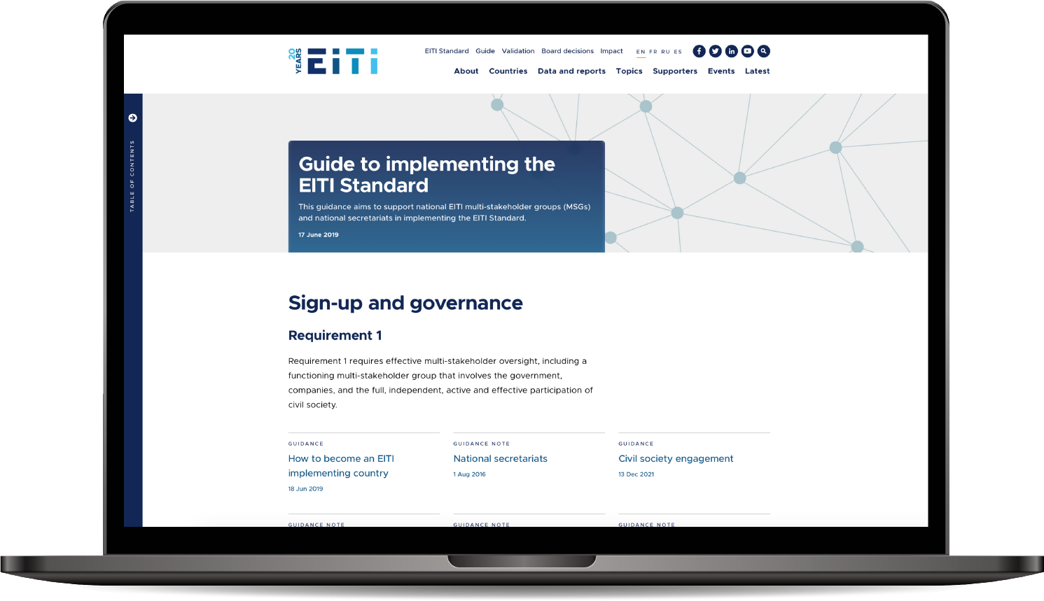

Consult our guidance at eiti.org/guide

Slide 48
Questions?

Slide 49
E-MAIL secretariat@eiti.org PHONE +47 22 20 08 00
ADDRESS EITI International Secretariat, Rådhusgata 26, 0151 Oslo, Norway

