Slide 1
2023 EITI Standard: Key changes
Energy transition
Notes:
Introduce the objectives for the presentation:
Understand how the energy transition is impacting the extractive industries and what role the EITI can play in navigating this process.
Three components to the presentation:
Discussion of how the energy transition is impacting the sector
Describe what the role of the EITI is in promoting transparency in the energy transition
Look in more detail at what is in the 2023 Standard
Annex includes more detail.

Slide 2


Content
The energy transition’s impact on the extractive industries
The role of the EITI in the energy transition
Using the 2023 EITI Standard

Slide 3
The energy transition and the extractive industries

Slide 4

What is the energy transition?
A global shift from fossil fuel-based energy to low-carbon alternatives
Motivated by climate change, energy security and energy access goals
Notes:
What do we mean when we say energy transition?
The term energy transition describes the global shift away from an energy system reliant on fossil fuels – i.e., oil, gas and coal - to one dominated by low-carbon forms of energy – such as wind, solar and hydropower.
It is useful to frame the energy transition as a global phenomenon. It is reshaping the extractive industries and is impacting resource-rich countries regardless of the domestic policies they pursue.
The energy transition is motivated by the need to tackle climate change, but also by energy security (e.g., reducing reliance on fossil fuel imports) and energy access goals (i.e., reducing energy poverty through renewables).

Slide 5

How is the energy transition impacting the energy and mining sectors?
REFLECTION
Notes:
Question: how are these changes impacting the energy and mining sectors? (Ask participants to reflect on the experience of their own countries)

Slide 6
How is the energy transition impacting the energy and mining sectors?
Shifting fossil fuel demand
Demand growth and volatility in minerals markets
Scaling up of low carbon technologies
Notes:
When talking about the energy transition, our focus lies on how the global shift away from fossil fuels impacts the extractive industries (and relatedly the renewable energy sector). We are not talking about broader energy transition themes that fall outside our core mandate like electricity transmission or energy efficiency.
To summarise the trends:
Fossil fuels:
- There is a strong consensus that global fossil fuel demand will decline in the long term.
- But that journey won’t be linear (e.g., we’ve seen fossil fuel demand increase in the wake of Russia’s invasion of Ukraine).
- And it won’t impact all fossil fuels in the same way (e.g., there is much broader consenus on phasing out coal than on the future of gas. Many countries and companies view gas as having an important role to play in the energy transition).
2 Minerals.
- Likewise useful to caveat predictions for the minerals sector.
- We are llikely to see overall increase in minerals demand, but it is hard to predict trajectory for specific minerals.
- We are likely to see strong demand but also volatility.
3. Renewables
- And the other side of the story is that as fossil fuel demand declines we are seeing huge growth in renewables with many similarities in the governance challenges we know well from extractives.

Slide 7
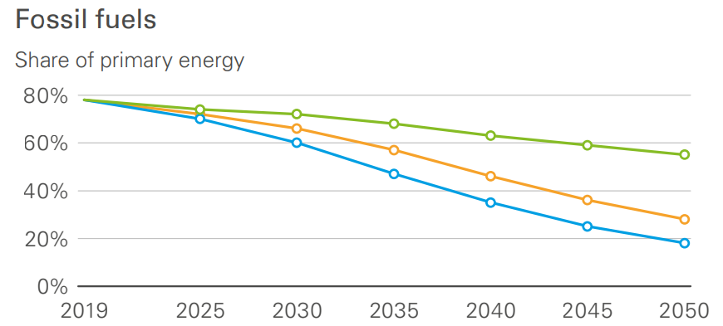
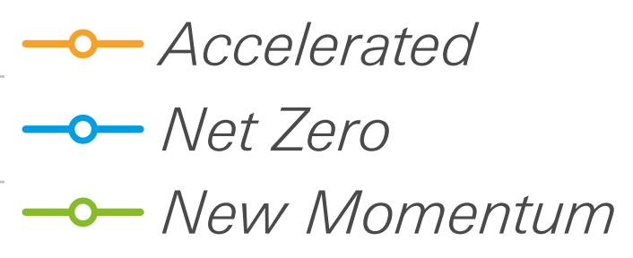
Global fossil fuel demand to decline, even if global climate action falls short of net zero goals
Source: BP Energy Outlook

Slide 8
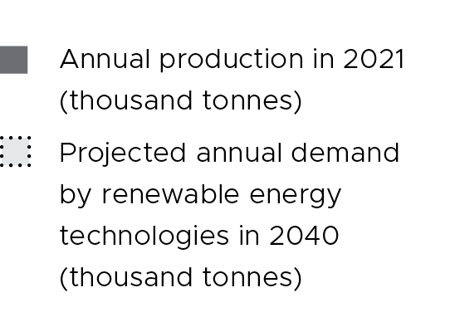
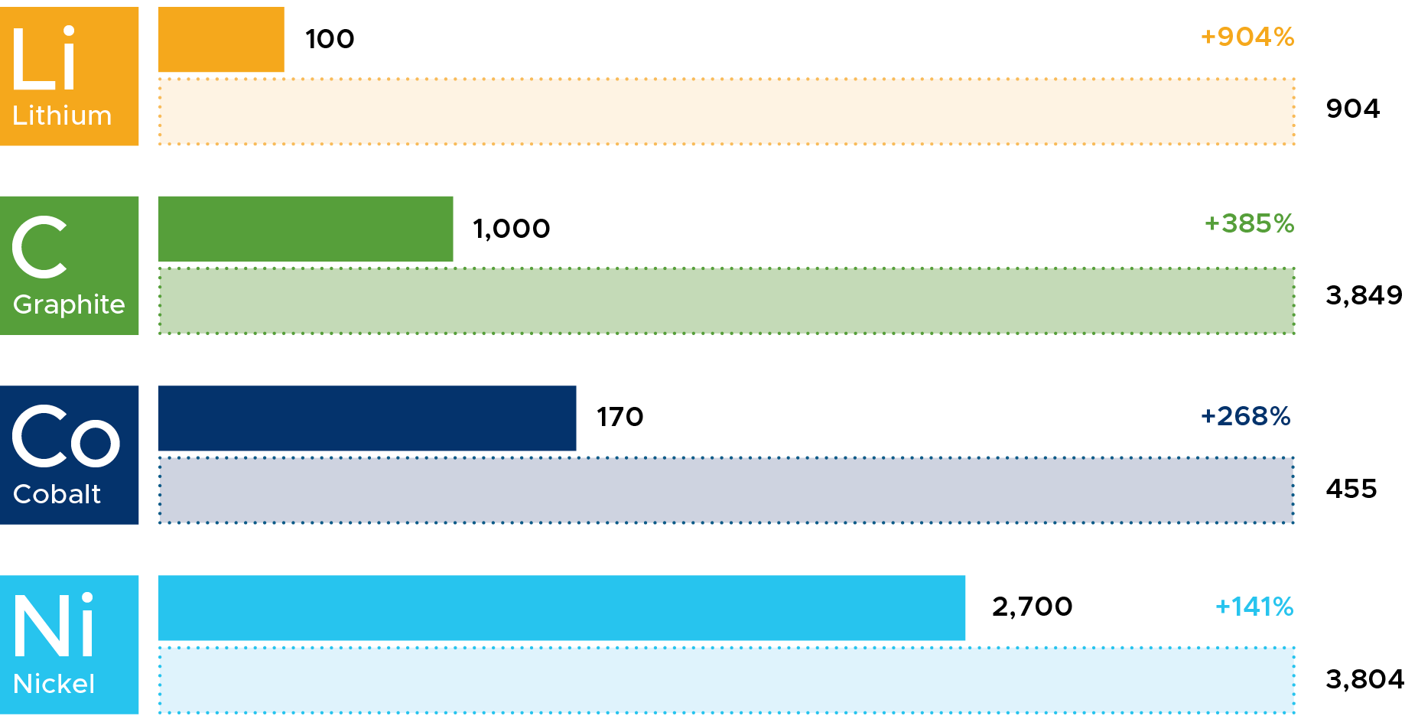
Overall minerals demand expected to grow dramatically – but trajectories for specific minerals are uncertain
Annual production in 2021 (thousand tonnes)
Projected annual demand by renewable energy technologies in 2040 (thousand tonnes
→ See EITI Mission Critical Report
Source: EITI and Sustainable Minerals Institute (based on IEA and USGS data)

Slide 9
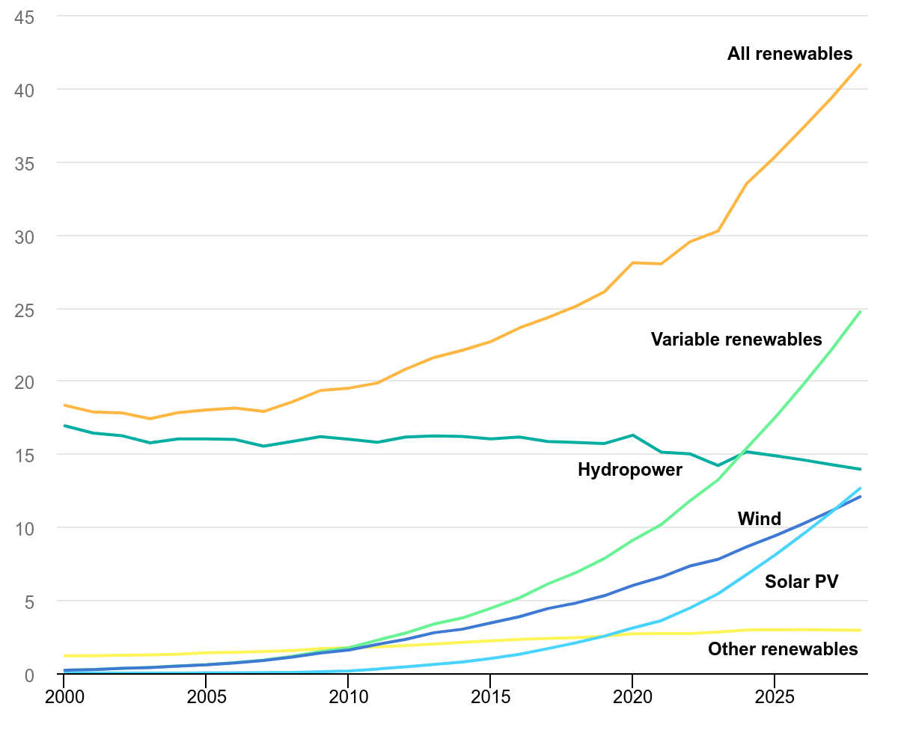
Renewable energy sector to continue experiencing rapid growth
Source: IEA, Renewables 2023

Slide 10
The role of the EITI in the energy transition

Slide 11
What is the role of the EITI in the energy transition?
REFLECTION
Notes:
Ask the audience to respond to this questions and summarise their replies. (consider also asking the audience to specifically identify what the limits of the EITI’s role are)

Slide 12

What is the role of the EITI in the energy transition?
Provide data and dialogue to help resource-rich countries navigate the implications of the energy transition for their extractive sectors
The role of the EITI is not to tell countries if, when and how to transition their own energy sectors
Notes:
The EITI’s role is not to tell countries what energy transition policies to pursue but to recognise the energy transition as a global trend and to provide disclosures and dialogue platforms that support accountability in a changing industry.

Slide 13



What opportunities and challenges does the energy transition present?
Economic opportunities and challenges
Corruption risks
Community impacts
Notes:
What are the tangible ways in which this impacts resource-rich countries:
Economic opportunities and challenges, especially impacts on government revenues but also public finance risks related to SOE investments.
New corruption risks, particularly in the mining sector given the anticipation of a boom
Community impacts – e.g., impacts on jobs and traditional livelihoods, subnational revenues, environmental impacts

Slide 14
Why is data and dialogue important in the energy transition?
REFLECTION
Notes:
Ask the audience to respond to this questions and summarise their replies.

Slide 15
Why is data and dialogue important in the energy transition?
Identify economic and governance opportunities and risks
Ensure government and company actions align with long-term public interests
Build trust between stakeholders
Notes:
- Transparency and dialogue are needed to idenitfy economic and governance opportunities and risks.
- This can help to hold government and companies accountable and ensure their actions align with long-term public interests.
- The ultimate aim is to build trust between stakeholders and deliver an accountable energy transition.

Slide 16
The 2023 EITI Standard and the energy transition

Slide 17
2023 EITI Standard
The EITI Standard has evolved to respond to stakeholder needs and a changing global context.
New and refined provisions enable countries to respond to the most pressing challenges that concern natural resource governance today, including the energy transition.

Slide 18
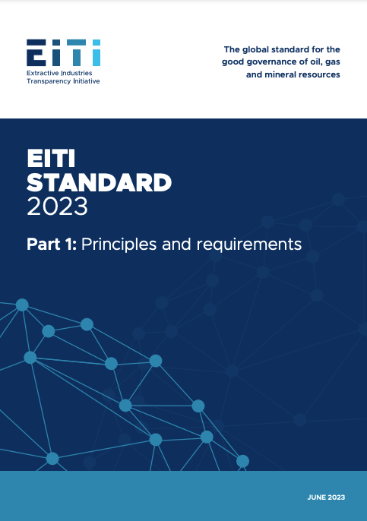
What’s in the 2023 Standard?
Strengthened disclosures to:
Promote policy coherence (Req. 2.1)
Manage economic opportunities and challenges (especially Reqs. 2.6 and 5.3)
Advance anti-corruption efforts (especially Req. 2.2)
Strengthen the voice of communities (especially Reqs. 2.2, 6.3 and 6.4)
Shed light on GHG emissions (especially Req. 3.4)

Slide 19
What’s in the 2023 Standard?
Additional requirements to:
Ensure energy transition is considered in MSG workplans (especially Reqs. 1.4 and 1.5)
Promote evidence-based public debate on the energy transition (especially Req. 7.1)

Slide 20



Thematic areas
Energy transition policies and plans
Economic impacts
Anti-corruption
Community impacts
Greenhouse gas emissions

Slide 21
Energy transition policies
Requirement 2.1 promotes policy coherence through:
Requirement to disclose relevant energy transition commitments, policies and plans
Encouragement to disclose carbon pricing, subsidies and reforms
Notes:
- Government policies on climate change and the energy transition can have an impact on the extractive industries. At the same time, government policy on extractives can influence the success of efforts to mitigate climate change.
- Building a clear picture of the policy landscape and fiscal regime, the relationship between climate, energy and extractives policies, the implications for the production of minerals or fossil fuels is important for promoting coordination and alignment between government institutions and ensuring government action serves long-term public interests.

Slide 22

Germany
POLICY COHERENCE AND COORDINATION
CASE STUDY
Ambitious energy transition commitments
Reporting on coal phase-out policies
Contextual information on renewable energy sector
Notes:
Germany is a significant producer of lignite (brown coal), which is used for electricity generation in Europe and domestically. The country has committed to phasing out coal-fired power and lignite mining by 2038 at the latest. Concurrently, the use of renewable energy sources is steadily increasing in Germany’s energy mix.
Germany uses the EITI for multi-stakeholder dialogue and reporting on national energy transition policies. EITI reporting describes legislation to phase out coal, including details on subsidies for the decommissioning of coal-fired power plants. Reporting also covers environmental protection and restoration requirements, federal support for coal mining regions, and details on the national emissions trading scheme.
Moreover, EITI reporting provides contextual information about the country’s renewable energy sector, including market trends, details on subsidies, and an analysis of the sector’s economic contributions, including its impact on employment.

Slide 23

Economic impacts
Requirements 2.6 and 5.3 shed light on economic opportunities and risks through:
Encouragement to explain how energy transition and climate risk factor into revenue forecasts
Encouragement to disclose how SOE investments align with energy transition and climate risk
Notes:
The energy transition is impacting global supply and demand for oil, gas and minerals. This shift has implications for investment decisions, project viability, government revenues and the sector’s broader economic contributions.
Both governments and citizens require a clear understanding of how the energy transition impacts the viability of extractive projects and the overall economic contribution of the sector – and ensure that investment decisions, revenue management and economic planning are aligned with long-term public interests.

Slide 24

Mauritania
PUBLIC FINANCE RISKS AND ECONOMIC VULNERABILITIES
CASE STUDY
Significant natural gas and green hydrogen potential
Assessment of revenue impacts of different climate and price scenarios
Recommendations to support responsible growth
Notes:
As countries intensify their efforts to meet climate targets, some are investing in natural gas, a cleaner-burning alternative to more carbon-intensive fossil fuels.
Additionally, there is growing interest and investment in green hydrogen, a means of storing energy produced by extracting hydrogen from water molecules using renewable electricity.
For Mauritania, a country endowed with substantial natural gas reserves and considerable renewable energy potential, these global trends hold the promise of significant opportunities.
To gain a deeper understanding of how these trends might impact the country’s economy, EITI Mauritania commissioned a study to explore how the gas and green hydrogen sectors might contribute to government revenues under various price scenarios. The study, supported by USAID, provided recommendations for ensuring responsible management of growth in these sectors.

Slide 25

Anti-corruption
Requirement 2.2 helps to identify and address corruption risk through:
Requirement to document fast-tracked license awards
Notes:
The energy transition is reshaping corruption risks in the extractive industries. Experience shows that rapid deal-making, coupled with expectations of high profits, can drive corruption. This is especially pertinent in the award of licenses, procurement contracts and commodity trading deals.
The dynamic is particularly relevant to the mining sector, where the energy transition is driving demand growth.
To support a just energy transition, the extractive sector needs to take decisive action on corruption.
Transparency on the awarding of licenses and contracts, as well as governance of SOEs, can help to support anti-corruption efforts.

Slide 26

Philippines
ANTI-CORRUPTION
CASE STUDY
Top nickel producer, a key transition mineral
In-depth investigation of integrity risks in nickel licensing
Development of an action plan to mitigate risks
Notes:
The Philippines is one of the world’s top producers of nickel, an important transition mineral that is expected to see growing demand due to its use in a range of low-carbon technologies.
To better understand potential corruption risks related to nickel extraction, the Philippines EITI commissioned an integrity study with support from USAID in 2023.
The study used a corruption diagnostic tool, developed by NRGI, to conduct an in-depth investigation of integrity risks, including in the licensing and contracting procedures for large-scale nickel mines.
It provided recommendations for mitigating governance and corruption risks, as well as an action plan for the Philippines EITI to address priority risks and strengthen its anti-corruption work.

Slide 27

Community impacts
Requirements 2.2, 6.3 and 6.4 strengthen the voice of communities through:
Expectation to disclose consultation processes, including FPIC requirements
Requirement to disclose disaggregated employment data
Requirement to disclose environmental, social and gender impact assessments
Notes:
- The energy transition carries profound implications for individuals and communities living near energy and mining projects. It is transforming livelihoods and creating new opportunities and challenges.
- To support a just, inclusive and sustainable energy transition, community stakeholders need information that helps them understand how the extractive industries are impacting their lives. This information must support greater accountability and provide communities with opportunities for meaningful participation in dialogue with government and companies regarding decisions that affect them.

Slide 28

COMMUNITY IMPACTS
CASE STUDY
Colombia, Ghana and Indonesia
“Engaging communities in a just transition” project
Assessed energy transition’s community impacts and obstacles to access and use data and dialogue platforms
Developed community engagement plans with options to strengthen the EITI’s role at local level
Notes:
To advance community priorities in the energy transition, the EITI launched the “Engaging communities in a just transition” project in early 2022 with support from the Ford Foundation.
Implemented in four subnational areas in Colombia, Ghana and Indonesia, this two-year project explored how the energy transition is impacting community livelihoods and the obstacles that citizens face in accessing and using data and dialogue platforms.
The project sought to identify options for using the EITI to advance community voices in the energy transition. The EITI worked in communities reflecting a diverse range of energy transition dynamics – from coal mining and renewables investments in Colombia, to oil and gas facilities in Ghana and nickel mining and smelting in Indonesia.
As part of the project, local partners developed community engagement plans in consultation with community representatives and national EITI stakeholders. These plans focused on identifying practical actions that the EITI could take to strengthen the initiative’s relevance at the community level, including by ensuring that EITI reporting covers the issues that matter most to communities, identifying innovative approaches for disseminating EITI data, and facilitating community participation in dialogue and decision-making on the energy transition.

Slide 29

Greenhouse gas emissions
Requirements 3.1, 3.2 and 3.4 shed light on emissions through:
Encouragement to disclose emissions in line with existing standards
Encouragement to disclose oil, gas and mineral reserves
Requirement to disclose production volumes
Notes:
Reducing greenhouse gas emissions is a top priority in the fight against climate change and represents a central objective of the energy transition.
Data on greenhouse gas emissions is a matter of immense public interest.
The extractive industries contribute to greenhouse gas emissions through emissions directly associated with extractive operations and, in the case of oil, gas and coal, emissions released during the combustion of these resources by end-users.
Transparency in this regard can support greater accountability around the climate commitments of governments and companies.

Slide 30

GREENHOUSE GAS EMISSIONS
CASE STUDY
Trinidad and Tobago
Major global exporter of liquified natural gas
Establishment of voluntary process for emissions reporting
State-owned NGC is the first company to disclose disaggregated emissions data through the EITI
Notes:
Trinidad and Tobago is one of the world’s largest exporters of liquefied natural gas, and Trinidad and Tobago EITI (TTEITI) has played an important role in improving the availability of extractive sector data and fostering public awareness around climate change and the energy transition.
TTEITI has established an environmental subcommittee to oversee work on emissions reporting. It has also developed a voluntary process for oil and gas companies to report on their environmental impacts, including CO₂ and methane emissions.
Through EITI reporting, the country’s national gas company, NGC, became the first to disclose emissions data in a disaggregated manner.

Slide 31

Options for MSGs
Cover new requirements in reporting (e.g., Germany reporting on energy transition policies and subsidies)
Commission studies (e.g., Mauritania revenue forecasting; Philippines corruption diagnostic; Ghana minerals assessment)
Facilitate dialogue and debate (e.g., Colombia national energy transition forum)
Notes:
Describe options and flag considerations:
- What are the country’s priorities?
- What is the level of capacity? (e.g., are systematic disclosures feasible)

Slide 32
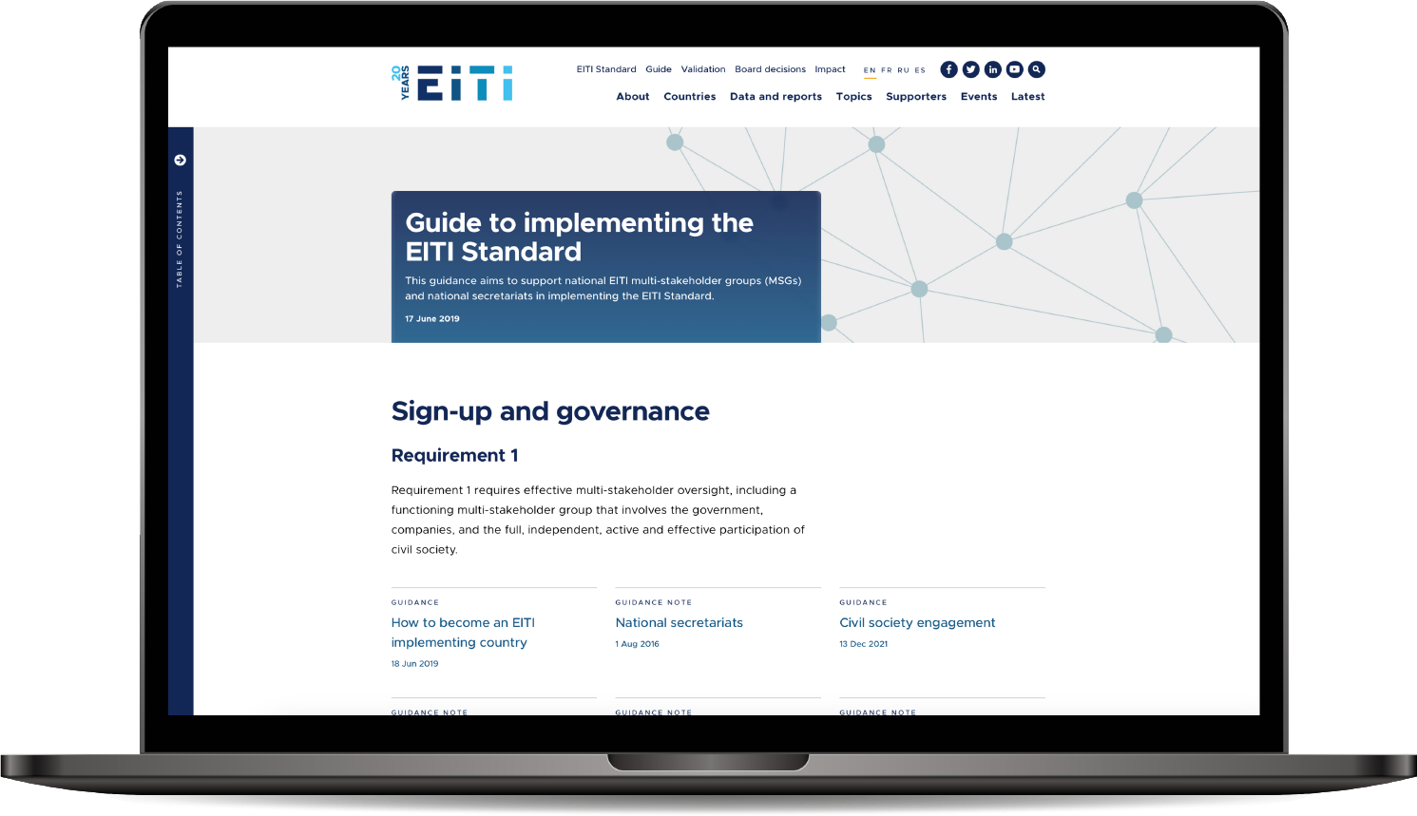

Consult our guidance at eiti.org/guide

Slide 33
Questions?

Slide 34

Annexe: detail on key aspects

Slide 35



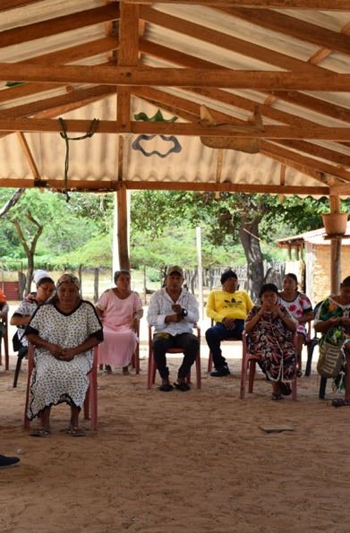
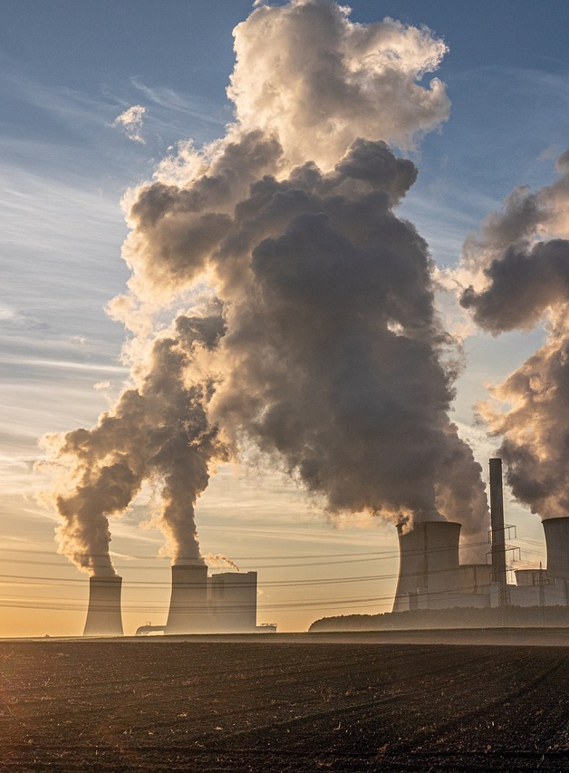
Key aspects
POLICY COHERENCE & COORDINATION
ECONOMIC PLANNING
ANTI-CORRUPTION
COMMUNITY ENGAGEMENT
EMISSIONS REPORTING
Notes:
When it comes to key changes to the EITI Standard that pertain to reporting on the energy transition, these can be broadly grouped into five categories:
Promoting policy coherence and coordination
Managing public finance risks and economic vulnerabilities
Advancing anti-corruption efforts
Strengthening the voice of communities
Shedding light on greenhouse gas emissions

Slide 36

KEY ASPECT
Supporting policy coherence and coordination

Slide 37
Summary
POLICY COHERENCE & COORDINATION
Climate, energy and extractives policies must align to support long-term public interests
Transparency on policies and fiscal terms can support coherence and coordination
Notes:
- Government policies on climate change and the energy transition can have an impact on the extractive industries. At the same time, government policy on extractives can influence the success of efforts to mitigate climate change.
- Building a clear picture of the policy landscape and fiscal regime, the relationship between climate, energy and extractives policies, the implications for the production of minerals or fossil fuels is important for promoting coordination and alignment between government institutions and ensuring government action serves long-term public interests.

Slide 38
Rationale
POLICY COHERENCE & COORDINATION
Understand how decarbonisation efforts affect the extractive industries
Identify sector policies that support or hinder climate action
Promote coherence and coordination to advance long-term public interests
Notes:
Data is vital for understanding how government decarbonisation efforts affect the extractive sector. It can also shed light on how government policies in the extractive industries either support or hinder climate change mitigation.
For example, data on carbon pricing, taxes, subsidies and tax deductions can help stakeholders understand whether the government and state-owned enterprises (SOEs) are using fiscal tools to incentivise or discourage extractive activities.
EITI disclosures can ahelp to identify instances where there is a lack of policy coherence or coordination among government institutions, for example licensing decisions or fiscal policies that are at odds with global demand projections.
Transparency in this area can support alignment of government policy with long-term public interests.

Slide 39
POLICY COHERENCE & COORDINATION
Requirement 2.1(b)
Implementing countries are required to disclose an overview of national energy transition commitments, policies and plans that are relevant to the extractive industries.
Notes:
The 2023 EITI Standard requires the disclosure of national energy transition commitments, policies and plans relevant to the extractive industries. This could include, for example, relevant nationally determined contributions, policies to phase down or phase out fossil fuels, transition mineral strategies, or just transition plans.
This information can shed light on the relationship between government policy on climate, energy and extractives and support better alignment and coordination.

Slide 40
POLICY COHERENCE & COORDINATION
Requirement 2.1(c)
Implementing countries are encouraged to disclose a summary description of carbon pricing mechanisms or carbon taxes that are material to the extractive industries.
Notes:
Carbon pricing mechanisms are policy approaches aimed at reducing greenhouse gas emissions by assigning a monetary cost to carbon dioxide and other greenhouse gas emissions. They can take various forms, such as carbon taxes or emissions trading schemes. They are market-based strategies to incentivise the shift to less carbon-intensive activities.
Transparency in this area can shed light on whether the government is putting in place measures to incentivise companies and consumers to reduce emissions.
[If asked for more detail: In a carbon tax system, a set price per ton of CO2 emissions is imposed on businesses or consumers, encouraging them to reduce emissions by making carbon-intensive activities more expensive. Emissions trading systems or cap and trade schemes - on the other hand, set a limit (or cap) on total emissions and allow entities to trade emission allowances, creating a market incentive to reduce emissions efficiently.]

Slide 41
POLICY COHERENCE & COORDINATION
Requirement 2.1(d)
Implementing countries are encouraged to disclose public subsidies and other forms of state support that are material to the extractive industries, as well as any related ongoing reforms.
Notes:
Similarly to carbon pricing, public subsidies are a tool governments can use to incentivise or disincentivise certain forms of company and consumer behaviour. Particularly relevant are fossil fuel subsidies, which refers to financial incentives or government support provided to the oil, gas and coal industry. These subsidies can take the form of tax breaks, direct payments, or other financial benefits designed to lower the production and consumption costs of fossil fuels. Fossil fuel subsidies can discourage the adoption of cleaner and more sustainable energy sources, exacerbate greenhouse gas emissions, and hinder efforts to combat climate change.
Beyond fossil fuels, in the context of the energy transition, governments might also provide subsidies and support to the renewable energy sector or transition minerals sector.

Slide 42
POLICY COHERENCE & COORDINATION
Requirement 2.1(e)
Where the government is undertaking reforms including with respect to national energy transition commitments, policies and plans, the multi-stakeholder group is encouraged to document them.
Notes:
Requirement 2.1(e) encourages disclosure of reforms that underway related to any of the types of government policies and plans described above.

Slide 43
Germany
POLICY COHERENCE AND COORDINATION
CASE STUDY
Ambitious energy transition commitments
Reporting on coal phase-out policies
Contextual information on renewable energy sector
Notes:
Germany is a significant producer of lignite (brown coal), which is used for electricity generation in Europe and domestically. The country has committed to phasing out coal-fired power and lignite mining by 2038 at the latest. Concurrently, the use of renewable energy sources is steadily increasing in Germany’s energy mix.
Germany uses the EITI for multi-stakeholder dialogue and reporting on national energy transition policies. EITI reporting describes legislation to phase out coal, including details on subsidies for the decommissioning of coal-fired power plants. Reporting also covers environmental protection and restoration requirements, federal support for coal mining regions, and details on the national emissions trading scheme.
Moreover, EITI reporting provides contextual information about the country’s renewable energy sector, including market trends, details on subsidies, and an analysis of the sector’s economic contributions, including its impact on employment.

Slide 44

KEY ASPECT
Managing public finance risks and economic vulnerabilities

Slide 45
Summary
PUBLIC FINANCE RISKS AND ECONOMIC VULNERABILITIES
Shifts in commodity prices create economic opportunities and challenges
Data can help to mitigate risks and support long-term planning
Notes:
The energy transition is impacting global supply and demand for oil, gas and minerals. This shift has implications for investment decisions, project viability, government revenues and the sector’s broader economic contributions.
Both governments and citizens require a clear understanding of how the energy transition impacts the viability of extractive projects and the overall economic contribution of the sector – and ensure that investment decisions, revenue management and economic planning are aligned with long-term public interests.

Slide 46
Rationale
PUBLIC FINANCE RISKS AND ECONOMIC VULNERABILITIES
Understand impacts on project viability, revenues and broader economic contributions
Scrutinise SOE investments to ensure alignment with public interests
Notes:
Background:
For fossil fuel producers, global decarbonisation efforts create economic uncertainties. Conversely, countries producing transition minerals may experience economic opportunities but also face challenges tied to market volatility.
EITI disclosures can help stakeholders to understand and navigate these economic opportunities and challenges.
Assessing project viability
- The pace and scale of global decarbonisation efforts has implications for commodity prices. EITI disclosures provide valuable information on how these changes might affect individual oil, gas and mining projects, including the risk of projects becoming commercially unviable “stranded assets”, and the potential consequences for government finances.
Understanding macroeconomic opportunities and challenges
EITI data can also shed light on the economic dependence and susceptibility of government revenues as a whole.
EITI disclosures can shed light on the role of the extractive industries in a country’s economy and how it could evolve during the energy transition.
For example, a country that is heavily reliant on its fossil fuel industry may use this data to initiate discussions on mitigating economic shocks that may arise from shifts in global demand.
EITI data can also provide insights into how the sector’s economic importance might change over time, allowing stakeholders to identify economic opportunities and challenges, and facilitating effective revenue management and long-term economic planning.
Scrutinising investments by state-owned enterprises
- Finally, EITI data can inform debate on the implications of licensing decisions and investments made by state-owned enterprises, and their alignment with public interests.
The energy transition is influencing investment decisions made by SOEs. In several countries, the strategic importance and estimated economic value of transition minerals are driving calls for increasing state participation in the mining sector. Elsewhere, SOEs are investing in fossil fuel projects, despite concerns about their compatibility with global emissions targets.
EITI disclosures can inform discussions on whether SOE investments align with long-term public interests.

Slide 47
PUBLIC FINANCE RISKS AND ECONOMIC VULNERABILITIES
Requirement 5.3(b)
Implementing countries are expected to disclose any forecasts related to future revenues from the extractive sector, including the underlying assumptions related to projected production levels, project costs and commodity prices, where they exist.
The government is encouraged to explain how energy transition and climate risk considerations have been considered in revenue forecasting.
Notes:
Requirement 5.3(b) Critical data includes government assumptions around future production levels, project costs and commodity prices. Stakeholders can use this information in combination with fiscal terms to develop financial models, which estimate the extent to which projects are vulnerable to changing market dynamics and can identify associated risks to public finances.

Slide 48
PUBLIC FINANCE RISKS AND ECONOMIC VULNERABILITIES
Requirement 5.3(c)
When requested by the multi-stakeholder group, oil, gas and mining companies are encouraged to disclose projected project production levels, and estimated timelines related to cost recovery.
Notes:
5.3 (c) encourages similar disclosures from companies, with a focus on projected project-level production levels and cost recovery timelines. This can further support forward-looking analysis on economic opportunities and challenges.

Slide 49
PUBLIC FINANCE RISKS AND ECONOMIC VULNERABILITIES
Requirement 2.6(d)
Where applicable, SOEs are encouraged to disclose:
Investments in the extractive industries (including assets and liabilities)
How their investment decisions are aligned with energy transition and climate risk considerations
Notes:
- The EITI Standard encourages SOEs to disclose their investments in the extractive sector offering insight into how public funds are invested and associated risks.
- Moreover, SOEs are encouraged to disclose how considerations related to the energy transition and climate change influence their investment decisions. These disclosures can enhance public understanding and foster debate on the extent to which SOEs are proactively managing the opportunities and risks posed by the energy transition.

Slide 50
Mauritania
PUBLIC FINANCE RISKS AND ECONOMIC VULNERABILITIES
CASE STUDY
Significant natural gas and green hydrogen potential
Assessment of revenue impacts of different climate and price scenarios
Recommendations to support responsible growth
Notes:
As countries intensify their efforts to meet climate targets, some are investing in natural gas, a cleaner-burning alternative to more carbon-intensive fossil fuels.
Additionally, there is growing interest and investment in green hydrogen, a means of storing energy produced by extracting hydrogen from water molecules using renewable electricity.
For Mauritania, a country endowed with substantial natural gas reserves and considerable renewable energy potential, these global trends hold the promise of significant opportunities.
To gain a deeper understanding of how these trends might impact the country’s economy, EITI Mauritania commissioned a study to explore how the gas and green hydrogen sectors might contribute to government revenues under various price scenarios. The study, supported by USAID, provided recommendations for ensuring responsible management of growth in these sectors.

Slide 51

Republic of the Congo
PUBLIC FINANCE RISKS AND ECONOMIC VULNERABILITIES
CASE STUDY
Major role for oil and gas in government revenues
Disclosure of production, sales and cost data and contracts
Analysis of past trends and future revenue potential
Notes:
In the Republic of the Congo, the extractive industries contribute more than half of the government’s total revenues. EITI reporting has played a crucial role in gathering valuable information.
In 2013, the country began publishing oil production data for all licenses, and three years later it expanded its disclosures to include all individual oil sales and project costs for each license. The government also discloses all its oil contracts in full.
These disclosures have enabled the EITI in the Republic of the Congo to conduct an analysis of past trends and forecast potential future revenues under different scenarios.
Using financial modelling, the study looked at past and expected future payments from key oil projects as well as companies' oil sales, to promote an informed debate based on the analysis of EITI data and examine the effectiveness of Congo’s fiscal policies.

Slide 52

Ghana
PUBLIC FINANCE RISKS AND ECONOMIC VULNERABILITIES
CASE STUDY
Mapping of socio-economic opportunities related to transition minerals
Recommendations for strengthening governance
Findings have informed Ghana’s National Energy Transition Framework
Notes:
In Ghana, the EITI commissioned a study, with support from USAID, to map the socio-economic opportunities and governance challenges in the country’s transition minerals sector. The study aimed to empower policymakers and stakeholders with credible data to navigate the complexities of this evolving landscape.
The report offered insights on the evolving role of the minerals sector in the energy transition. It presented key information on proven reserves for four selected transition minerals, assessed the legal and regulatory framework governing the sector, and examined the fiscal, social and environmental opportunities and challenges.
To respond to growing global demand, the report recommended the need to optimise the country’s mining legal and fiscal regime to ensure the sector can add value beyond solely extracting for export.
Findings from the report have since informed Ghana’s National Energy Transition Framework, published in November 2022, as well as public debate around the need for critical mineral beneficiation policies. The government is currently updating its mining policy, which is expected to align with recommendations from the report to integrate critical minerals as part of the government’s energy policy.

Slide 53

KEY ASPECT
Advancing anti-corruption efforts

Slide 54
Summary
ANTI-CORRUPTION
The energy transition is reshaping corruption risks
Key risk areas are the award and transfer of licenses and SOE governance
Notes:
The energy transition is reshaping corruption risks in the extractive industries. Experience shows that rapid deal-making, coupled with expectations of high profits, can drive corruption. This is especially pertinent in the award of licenses, procurement contracts and commodity trading deals.
The dynamic is particularly relevant to the mining sector, where the energy transition is driving demand growth.
In the fossil fuel sector, the decision by some companies to divest from riskier projects may expose new corruption challenges related to license transfers.
To support a just energy transition, the extractive sector needs to take decisive action on corruption.
Transparency on the awarding of licenses and contracts, as well as governance of SOEs, can help to support anti-corruption efforts.

Slide 55
Rationale
ANTI-CORRUPTION
Identify and mitigate corruption risks in license and contract awards
Strengthen SOE governance
Notes:
Promoting accountable license and contract awards
License and contract awards are often susceptible to corruption. This challenge is particularly apparent in the transition minerals sector where growing demand can drive an uptick in investments. EITI disclosures play a role in mitigating these risks by strengthening transparency on license and contract awards.
Disclosures related to award criteria and processes can enable stakeholders to understand whether decision-making is transparent and competitive.
Strengthening SOE governance
A significant proportion of recent corruption cases in the oil, gas and mining sectors have involved SOEs. As SOEs pursue new business opportunities in the context of the energy transition, corruption risk may surface in areas such as the use of agents and intermediaries, supplier and contractor selection, and commodity trading.
EITI disclosures can help to strengthen SOE governance.

Slide 56
ANTI-CORRUPTION
Requirement 2.2(a)
Where governments use “fast-tracked” awards processes, the MSG must clearly document the rationale for this choice; the processes to which this applied; the procedures and criteria used; the institutions involved; and the outcomes of the processes.
Notes:
- An innovation in the 2023 EITI Standard is a explicit recognition of risks related to contexts where governments streamline or fast-track awards, which is particularly relevant where there is a motivation to expedite the production of transition minerals.
- EITI disclosures can unveil deviations from established rules in specific awards processes, potentially signalling instances where governance safeguards were circumvented.

Slide 57
Philippines
ANTI-CORRUPTION
CASE STUDY
Top nickel producer, a key transition mineral
In-depth investigation of integrity risks in nickel licensing
Development of an action plan to mitigate risks
Notes:
The Philippines is one of the world’s top producers of nickel, an important transition mineral that is expected to see growing demand due to its use in a range of low-carbon technologies.
To better understand potential corruption risks related to nickel extraction, the Philippines EITI commissioned an integrity study with support from USAID in 2023.
The study used a corruption diagnostic tool, developed by NRGI, to conduct an in-depth investigation of integrity risks, including in the licensing and contracting procedures for large-scale nickel mines.
It provided recommendations for mitigating governance and corruption risks, as well as an action plan for the Philippines EITI to address priority risks and strengthen its anti-corruption work.

Slide 58
Global anti-corruption expert group
ANTI-CORRUPTION
CASE STUDY
Expert group convened by EITI, NRGI and OECD
Call for action to identify and mitigate risks, strengthen environmental and social safeguards and promote transparency
Notes:
A group of anti-corruption experts convened by the Natural Resource Governance Institute (NRGI), the Organisation for Economic Co-operation and Development (OECD) and the EITI, issued a call for action urging governments, companies, investors, international organisations and others to implement measures aimed at preventing corruption in mineral supply chains for the energy transition.
These measures include stepping up efforts to identify and mitigate corruption risks, strengthening environmental and social safeguards and promoting information disclosures.
The EITI Standard stands as a valuable tool for addressing corruption risks in the transition minerals sector, offering a robust framework for transparency and accountability.

Slide 59
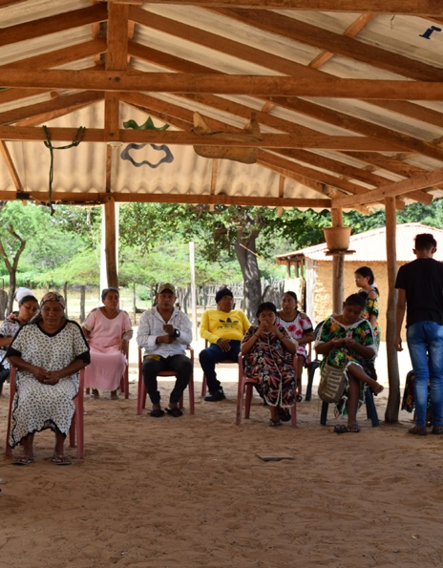
KEY ASPECT
Strengthening the voice of communities

Slide 60
Summary
COMMUNITY IMPACTS
Energy transition impacts livelihoods of communities living near energy and mining projects
Data and dialogue can support a just transition
Notes:
- The energy transition carries profound implications for individuals and communities living near energy and mining projects. It is transforming livelihoods and creating new opportunities and challenges.
- To support a just, inclusive and sustainable energy transition, community stakeholders need information that helps them understand how the extractive industries are impacting their lives. This information must support greater accountability and provide communities with opportunities for meaningful participation in dialogue with government and companies regarding decisions that affect them.

Slide 61
Rationale
COMMUNITY IMPACTS
Strengthen community participation in decision-making
Shed light on local economic contributions
Strengthen environmental and social performance
Notes:
Background
In regions experiencing increased investment, local governments and communities stand to gain new revenue streams, job opportunities and community spending from energy and mining companies. However, they also face potential disruptions to traditional livelihoods and environmental harm. Conversely, in regions with declining investments, local stakeholders grapple with revenue and job losses while dealing with the environmental legacy of past extractive activities. At times, individuals may experience these impacts differently depending on their gender and the role they play within their community.
Many of these opportunities and challenges are not new. But the speed and scale of the energy transition is intensifying the urgency of strengthening governance in the energy and mining sectors so that the world achieves its decarbonisation goals in a manner that respects the rights of communities.
Community participation
Involving local stakeholders in decisions that impact their lives is critical to ensuring the energy transition advances in a manner that respects community rights.
Stakeholders can use EITI disclosures to assess the extent to which community perspectives are taken into account in decision-making. This is particularly important in the transition minerals sector, where projects may take place in environmentally and socially sensitive areas, and where there is an urgent need to ensure strong safeguards of community rights.
Shedding light on local economic contributions
The energy transition is reshaping the extractive sector's local economic contributions. Areas producing transition minerals may benefit from new revenue flows, jobs and social spending by extractive companies. In other areas, the energy transition may pose uncertainties for local economies.
Stakeholders can harness EITI data to understand the implications of the energy transition for the extractive sector’s local economic contributions.
Strengthening environmental and social performance
The energy transition is driving new extractive projects and investments, often in environmentally and socially sensitive areas. Conversely, investment in fossil fuel projects is decreasing, affecting the livelihoods of local communities and raising concerns about environmental rehabilitation when these activities eventually cease.
These dynamics increase the urgency of strengthening the extractive sector’s environmental and social performance. The assessment, monitoring and management of environmental, social and gender impacts is a critical part of this.
Stakeholders can use EITI data to advance accountability regarding environmental and social performance. This can help to ensure communities and the environment are protected from harm as the extractive sector goes through significant changes.

Slide 62
COMMUNITY IMPACTS
Requirement 2.2
Where the process for awarding or transferring a license mandates consultations with impacted communities, countries and companies are expected to include a description of how the consultation process was conducted.
Notes:
In countries where community consultation is mandated by law, EITI implementing countries and reporting companies are expected to disclose a description of how consultation processes were conducted in practice. The EITI Standard also requires the disclosure of rules related to free, prior and informed consent in licensing processes. This can strengthen accountability around the extent to which communities were able to participate in decisions impacting their lives.

Slide 63
COMMUNITY IMPACTS
Requirement 6.3(a)
Where available, implementing countries are required to disclose employment information disaggregated by gender and occupational level, company and project, as well as between local and foreign nationals.
Notes:
The EITI Standard allows for transparency regarding the extractive sector’s broader economic contributions. Jobs are often top of the priority list for communities. Where available, implementing countries must disclose employment data disaggregated by gender and occupational level, as well as by company and project, and between local and foreign nationals. Stakeholders can use this data to verify whether companies are fulfilling their employment commitments, such as creating local jobs.

Slide 64
COMMUNITY IMPACTS
Requirement 6.4(b)
Countries and companies are required to ensure that environmental, social and gender impact assessments and monitoring reports […] are accessible to the public.
Notes:
The EITI Standard requires the disclosure of impact assessments and monitoring reports. This can shed light on the extent to which potential impacts have been properly assessed and effective mitigation measures developed.

Slide 65
COMMUNITY IMPACTS
Requirement 6.4(c)
Companies are encouraged to disclose further information about their social, gender and environmental management and impact.
Notes:
- The EITI Standard encourages companies to disclose information on how they manage impacts and encourages countries to disclose information on monitoring and enforcement activities, including in relation to water, land, emissions and human rights.
- Stakeholders can scrutinise monitoring data and details about enforcement activities to verify whether companies are meeting their obligations and to gauge the effectiveness of government efforts to uphold environmental and social standards.

Slide 66
COMMUNITY IMPACTS
CASE STUDY
Colombia, Ghana and Indonesia
“Engaging communities in a just transition” project
Assessed energy transition’s community impacts and obstacles to access and use data and dialogue platforms
Developed community engagement plans with options to strengthen the EITI’s role at local level
Notes:
To advance community priorities in the energy transition, the EITI launched the “Engaging communities in a just transition” project in early 2022 with support from the Ford Foundation.
Implemented in four subnational areas in Colombia, Ghana and Indonesia, this two-year project explored how the energy transition is impacting community livelihoods and the obstacles that citizens face in accessing and using data and dialogue platforms.
The project sought to identify options for using the EITI to advance community voices in the energy transition. The EITI worked in communities reflecting a diverse range of energy transition dynamics – from coal mining and renewables investments in Colombia, to oil and gas facilities in Ghana and nickel mining and smelting in Indonesia.
As part of the project, local partners developed community engagement plans in consultation with community representatives and national EITI stakeholders. These plans focused on identifying practical actions that the EITI could take to strengthen the initiative’s relevance at the community level, including by ensuring that EITI reporting covers the issues that matter most to communities, identifying innovative approaches for disseminating EITI data, and facilitating community participation in dialogue and decision-making on the energy transition.

Slide 67
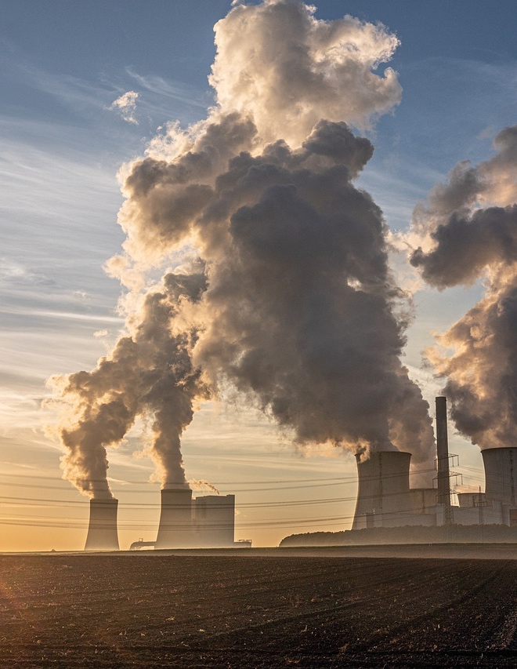
KEY ASPECT
Shedding light on greenhouse gas emissions

Slide 68
Summary
GREENHOUSE GAS EMISSIONS
Greenhouse gas reductions are central to the energy transition
Extractive industries have direct and indirect emissions
Data can support accountability about climate commitments
Notes:
Reducing greenhouse gas emissions is a top priority in the fight against climate change and represents a central objective of the energy transition.
Data on greenhouse gas emissions is a matter of immense public interest.
The extractive industries contribute to greenhouse gas emissions through emissions directly associated with extractive operations and, in the case of oil, gas and coal, emissions released during the combustion of these resources by end-users.
Transparency in this regard can support greater accountability around the climate commitments of governments and companies.

Slide 69
Rationale
GREENHOUSE GAS EMISSIONS
Understand greenhouse gas emissions of extractive companies
Use reserves and production data to estimate indirect emissions
Notes:
EITI disclosures can shed light on greenhouse gas emissions.
Corporate emissions disclosures can support better understanding of the emissions associated with a company’s operations.
Exploration, reserves and production data constitute another vital source of information on indirect emissions.

Slide 70
GREENHOUSE GAS EMISSIONS
Requirement 3.4
Companies are encouraged to disclose greenhouse gas (GHG) emissions in alignment with existing leading disclosure standards. Where feasible, the multi-stakeholder group is encouraged to request disaggregated disclosures.
Notes:
The EITI Standard encourages companies to disclose greenhouse gas emissions in line with existing disclosure standards and encourages EITI multi-stakeholder groups to request that this data be disaggregated.
Stakeholders can use this information to pursue accountability regarding companies’ commitments to reduce emissions.
Moreover, when emissions data is broken down at the country or project level, it becomes a valuable resource for governments seeking to understand the contribution of the extractive sector to national emissions. This can further bolster the credibility of national emissions data published by governments.
Project-level emissions data also provides governments and citizens with information about which projects are more likely to be impacted by company or government emissions targets.

Slide 71
GREENHOUSE GAS EMISSIONS
Requirement 3.1
Implementing countries and companies are encouraged to disclose data on proven economic oil, gas or mineral reserves, where available.
Notes:
Data on reserves from both companies and implementing countries enables analysis of the volume of fossil fuels that could be extracted in future. This can support an estimation of the greenhouse gas emissions that could result from the combustion of these fuels by end-users. This information can inform discussions concerning the alignment of current or potential fossil fuel extraction with emissions reduction goals.

Slide 72
GREENHOUSE GAS EMISSIONS
Requirement 3.2
Implementing countries are required to disclose timely production data, including production volumes and values by commodity. Data must be further disaggregated by project, where available.
Notes:
Similarly to reserves data, production data can support estimates of emissions associated with the combustion of fossil fuels by end users.

Slide 73
GREENHOUSE GAS EMISSIONS
CASE STUDY
Trinidad and Tobago
Major global exporter of liquified natural gas
Establishment of voluntary process for emissions reporting
State-owned NGC is the first company to disclose disaggregated emissions data through the EITI
Notes:
Trinidad and Tobago is one of the world’s largest exporters of liquefied natural gas, and Trinidad and Tobago EITI (TTEITI) has played an important role in improving the availability of extractive sector data and fostering public awareness around climate change and the energy transition.
TTEITI has established an environmental subcommittee to oversee work on emissions reporting. It has also developed a voluntary process for oil and gas companies to report on their environmental impacts, including CO₂ and methane emissions.
Through EITI reporting, the country’s national gas company, NGC, became the first to disclose emissions data in a disaggregated manner.

Slide 74
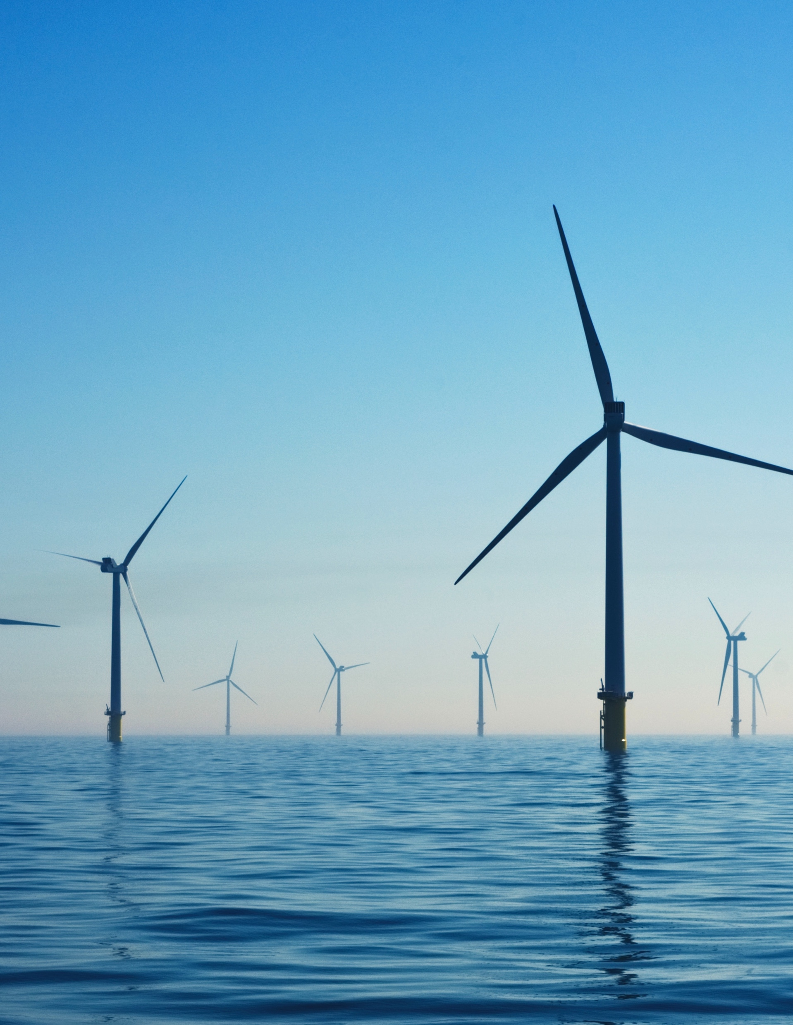
GOING FURTHER
Lessons for the renewable energy sector

Slide 75
Summary
LESSONS FOR RENEWABLES
Governance risks present obstacles to responsible growth in the renewables sector
Opportunities to share lessons on transparency and accountability from extractives
Notes:
The renewable energy sector has a critical role to play in helping countries reduce energy poverty and adopt pathways to a low-carbon future.
However, corruption and weak governance pose a threat to sustainable growth within the renewable energy sector. Violations of stakeholder rights could fuel perceptions that the sector is not working in the public interest, deter investments and increase the cost of doing business.
EITI implementation has shown the importance of transparency and multi-stakeholder dialogue in informing policy and decision-making on the extractive industries in the context of the energy transition.
To this end, EITI data and dialogue can also be a vehicle for advancing good governance in the renewable energy sector which is facing governance and corruption risks as investment in the sector increases.
The EITI has been exploring opportunities to share lessons between the sectors.

Slide 76
Options
LESSONS FOR RENEWABLES
Explore opportunities to broaden EITI reporting to cover renewables in selected areas
Involve renewables stakeholders in multi-stakeholder discussions
Notes:
Key areas of relevance include government policymaking on the renewables sector, licensing and contracting for renewables investments, beneficial ownership of renewable energy companies, and the sector’s social and environmental impacts.
Transparency is also needed on due diligence efforts in the mineral supply chains of renewable energy technologies.
Beyond transparency, there is a need for multi-stakeholder dialogue on governance challenges and collective action to advance accountability.

Slide 77

LESSONS FOR RENEWABLES
CASE STUDY
Albania
Important role for hydropower in domestic energy mix
Reporting on legal framework, production and revenues from hydropower
Notes:
Hydropower ranks as the second most important energy source in Albania after petroleum, and hydropower plants provide the main source of low-carbon electricity generation.
Albania’s EITI reporting goes beyond the EITI Standard by including information on its hydropower sector, including the legal and regulatory context of hydropower, production and revenue data, and reconciliation of subnational payments.
This reporting has revealed significant losses of power in the distribution system, which Albanian authorities are working to address.

Slide 78
Consult our guidance at eiti.org/guide

Slide 79
Questions?

Slide 80
E-MAIL secretariat@eiti.org PHONE +47 22 20 08 00
ADDRESS EITI International Secretariat, Rådhusgata 26, 0151 Oslo, Norway

