Slide 1
2023 EITI Standard: Key changes
Work planning and monitoring

Slide 2

Why is work planning and monitoring important?
REFLECTION
Notes:
Ask the audience to respond to this questions and summarise their replies.

Slide 3

Why is work planning and monitoring important?
REFLECTION
To answer: “Why implement the EITI in my country?”
Plan activities to achieve goals
Ensure best use of resources
Secure funding and buy-in from key stakeholders
Hold EITI process accountable
Learn and adjust
Notes:
Work plans should answer: Why do we implement the EITI in our country?
Then, they should answer how to reach those goals
What do we want to accomplish and how?
What resources do we have?
Who is responsible/accountable?
What are we missing? Why?
Work plans must also have room to monitor and evaluate progress along the way. Activities can be adjusted according to the priorities defined by the MSG.

Slide 4

REQUIREMENT 1.5
What’s changed?

Slide 5

What’s changed?
REQUIREMENT 1.5
The 2023 EITI Standard:
Reinforces link between work planning, monitoring and reporting cycle
Helps focus activities to achieve outcomes and impact
Merges Req. 1.5 and 7.4
Notes:
Objective of Req 1.5: To establish a consultative work planning and monitoring cycle that ensures the relevance and accountability of EITI implementation to national stakeholders, helping the EITI to achieve relevant outcomes and impacts.
Reqs 1.5 and 7.4 were previously detached processes, meaning that work planning was often happening without closely reflecting on whether objectives in the previous cycle were achieved and what could be improved.
These requirements are now merged and simplified to highlight the fundamental synergy between planning and evaluating.

Slide 6

Establish
work plan
Set objectives
Plan activites to meet objectives
Evaluate if objectives met
Have priorities changed?
Lessons, successes and challenges
Feed into next work plan
Notes:
Work plan to be updated annually
The review cycle should include a documentation step

Slide 7
Requirement 1.5(a)
REQUIREMENT 1.5
The multi-stakeholder group is required to maintain a work plan for implementation that addresses the most relevant themes for natural resource governance in line with national priorities.

Slide 8




Work plan must include:
Objectives that reflect national priorities
Measurable &
time-bound activities
Justification
of priority
EITI Requirements
Fully costed budget
Corruption, energy transition, gender equity, revenue collection, artisanal & small- scale mining, etc.
Notes:
Req. 1.5 EITI 2023 Standard
[…] The work plan must include:
EITI implementation objectives that reflect national priorities, including issues related to corruption; gender equity; energy transition; revenue collection; artisanal and small-scale mining (where applicable); and other key extractive sector governance issues, as well as consultations with key stakeholders.
Measurable and time-bound activities to achieve the agreed objectives and recommendations from Validation and reporting.
Justification of which EITI Requirements are prioritised, and a description of which activities in the work plan contribute to fulfilling each requirement.
A fully costed budget that identifies sources of funding

Slide 9
Requirement 1.5(b)
REQUIREMENT 1.5
The multi-stakeholder group is required to undertake an annual progress review of the work plan, which should inform the subsequent work plan.
Previously under Req. 7.4, now merged with Req. 1.5

Slide 10





Annual progress review must include:
Progress, challenges & changes
Overview of activities & outcomes
Description
of feedback mechanisms
Gender considerations
Expenses vs budget
Notes:
[…] The progress review must include:
Progress and challenges in achieving work plan objectives; changes in those objectives; and how implementation will be adapted to better achieve those objectives.
An overview of activities and outcomes achieved through EITI implementation.
A description of the mechanisms for stakeholders to provide feedback on EITI implementation, as well as documentation of stakeholder views.
Documentation on how the multi-stakeholder group has taken gender considerations and inclusiveness into account.
A report on actual expenses compared to the work plan budget.

Slide 11
Requirement 1.5(c)
REQUIREMENT 1.5
All work planning, monitoring and review activities must be informed by consultations with national stakeholders, and documented in formats that are publicly available.

Slide 12

MSGs are further encouraged to:
Measure progress of activities on a running basis
Consider publicly known corruption cases
Notes:
The multi-stakeholder group is encouraged to consider how to measure progress of the activities on a running basis, including an evaluation of whether their activities for the previous year contributed to improved governance of the extractive sector.
Where relevant, the multi-stakeholder group is encouraged to provide a narrative of whether it has considered publicly known corruption cases in the sector that are of national relevance for the year in review, and to document its discussion, response and recommendations.

Slide 13

KEY ASPECT
How to build a work plan

Slide 14

Linking EITI to national priorities
HOW TO BUILD A WORK PLAN
National context and priorities
2. Setting objectives that contribute to achieving national priorities
3. Planning activities to achieve objectives
1. Identifying national & sectoral priorities
Notes:
Work planning is an important step to ensure EITI implementation is meaningful and has impact in the country.
Broadly, it involves:
Identifying national & sectoral priorities related to extractives governance issues
Setting objectives for EITI implementation that contribute to achieving national priorities
Planning activities to achieve the MSG’s objectives

Slide 15





Five step approach
1. Organise
and prepare
2. Identify
priority issues
3. Define objectives, activities & scope
4. Monitor
and review
5. Plan again
Notes:
We can further break this down into six actionable steps that the MSG can take to build a robust work plan and review its work plan to support impactful EITI implementation.

Slide 16

BUILDING A WORK PLAN
STEP 1
Organise and prepare

Slide 17

Key questions
STEP 1: ORGANISE AND PREPARE
Who is responsible for work planning?
How much time and resources are needed to produce a work plan?
Which stakeholders should be consulted and how can their views be captured?
How should roles and timeframes be communicated to stakeholders?
  Tip: Ask the EITI International Secretariat for a work planning template!
Notes:
Results and issue-oriented work plans will re-engage and strengthen stakeholder engagement and actively contribute to public debate issues

Slide 18

BUILDING A WORK PLAN
STEP 2
Identify priority issues

Slide 19
Requirement 1.5(a)
STEP 2: IDENTIFY PRIORITY ISSUES
The multi-stakeholder group is required to maintain a work plan for implementation that addresses the most relevant themes for natural resource governance in line with national priorities.

Slide 20
Key questions
STEP 2: IDENTIFY PRIORITY ISSUES
What are the weak points in existing disclosure and implementation practice?
What are the national priorities for the extractive industries?
What do key stakeholders think about it?
How are current disclosure practices and national priorities understood by stakeholders?
Notes:
Start with what the main goals and objectives.
Identify what the challenges of natural resource governance are, from the perspective of government, civil society and industry.

Slide 21
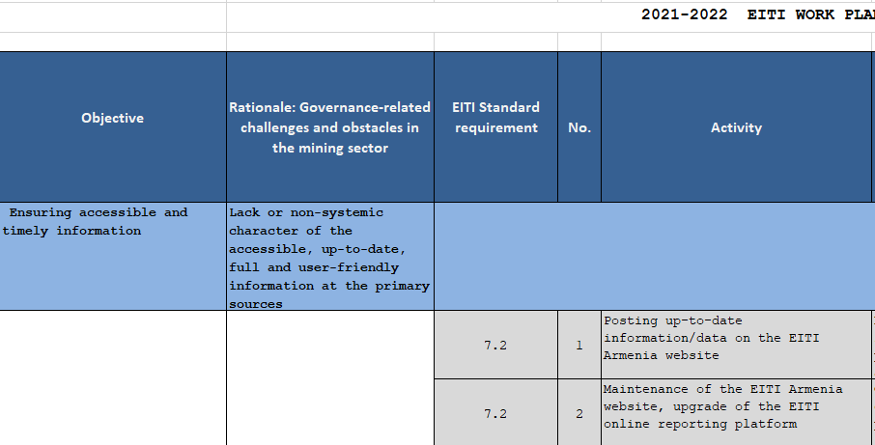
STEP 2: IDENTIFY PRIORITY ISSUES
EXAMPLE
Armenia
EITI work plan identifies rationale for each objective based on identified challenges
Proposes solutions/activites within MSG’s scope

Slide 22
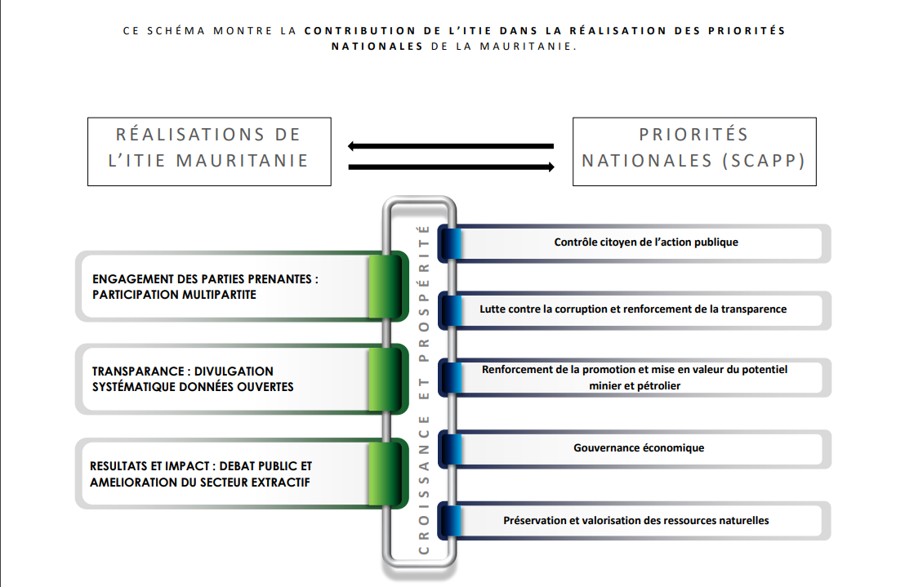
STEP 2: IDENTIFY PRIORITY ISSUES
EXAMPLE
Mauritania
EITI work plan links objectives of EITI implementation with national priorities

Slide 23
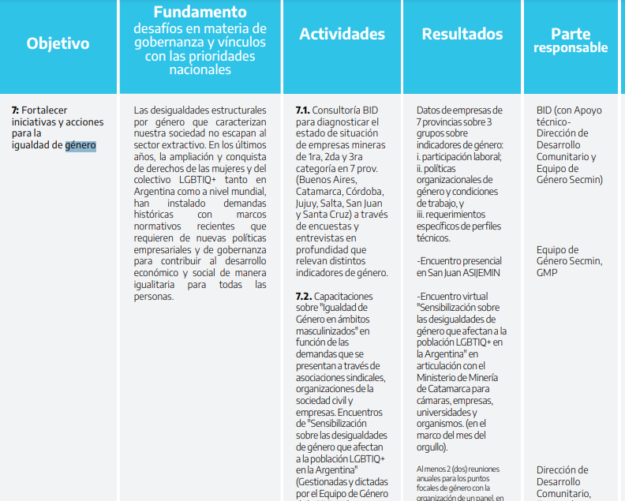
STEP 2: IDENTIFY PRIORITY ISSUES
EXAMPLE
Argentina
EITI work plan identifies lack of gender-disaggregated data
Includes capacity building activities on gender equality
Notes:
A

Slide 24

BUILDING A WORK PLAN
STEP 3
Define objectives, activities and scope

Slide 25
Key questions
STEP 3: DEFINE OBJECTIVES, ACTIVITIES AND SCOPE
Which activities will directly contribute to work plan objectives and other aspects of resource governance required by the EITI Standard?
Which EITI Requirements are prioritised, and why?
Are activities measurable and time-bound?
Are activities costed, and is funding available?
Who will carry out the activities?
What is the timeframe for carrying out activities, including communication and dissemination?

Slide 26





Setting SMART objectives
STEP 3: DEFINE OBJECTIVES, ACTIVITIES AND SCOPE
To achieve objectives and recommendations from Validation and reporting, activities should be:
Specific
Measurable
Achievable
Relevant
Time-bound
Notes:
Requirement 1.5 states that activities should be measurable and time-bound to achieve the agreed objectives and recommendations from Validation and reporting.
Specific: In order for a goal to be effective, it needs to be specific. A specific goal answers questions like what needs to be accomplished, who’s responsible for it, and what steps need to be taken to achieve it.
Measurable: Quantifying your goals makes it easier to track progress and know when you’ve reached the finish line
Achievable: Be ambitious, but be realistic! What can you do with your budget and with your timeline?
Relevant: Does your activity link to the challenges/priorities you have identified?
Time-bound: Each activity should have a timeframe for implementation. The timeframe should consider the deadlines established by the EITI Board for producing EITI Reports, annual activity reports and Validation. In developing the timetable, the MSGs should also consider administrative requirements such as procurement processes and funding.

Slide 27
Requirement 1.5(a)
STEP 3: DEFINE OBJECTIVES, ACTIVITIES AND SCOPE
The work plan must include:
Justification of which EITI Requirements are prioritised, and a description of which activities in the work plan contribute to fulfilling each requirement.
A fully costed budget that identifies sources of funding.
Notes:
Make a choice of what’s important for a given year, and why. You don’t need to cover all recommendations and corrective actions, but explain which ones were chosen
→ Have a full overview of all recommendations and corrective actions from reporting and Validation
Demonstrate prioritisation of which recommendations and requirements on in the upcoming year and which ones are down prioritised. Explain why.
Ensure there is regular (not ad-hoc) follow up on the status of all (prioritised and non-prioritised) recommendations and corrective actions

Slide 28
Consider the annual disclosure cycle
STEP 3: DEFINE OBJECTIVES, ACTIVITIES AND SCOPE
COMPLETE “Outcomes and impact template”
MSG with support from the national secretariat
Establish objectives of EITI
AGREE work plan
MSG with support from the national secretariat, in consultation with broader constituencies
Review outcomes and impact
COMPLETE “Stakeholder engagement template”
MSG with support from the national secretariat and each constituency
Review disclosures
MAP existing disclosures using “Transparency template” tool
MSG with support from the national secretariat, consultant or Independent Administrator
1 year
External Validation
every 12 to 36 months
MSG with support from the national secretariat and each constituency
Analyse and communicate data
Disclose data
COLLECT AND DISCLOSE data through government and company systems / EITI Report
Government agencies, companies and Independent Administrator
COMPLETE
“Transparency template”
MSG with support from the national secretariat, consultant and/or Independent Administrator
Oversee disclosures
Notes:
When work planning, consider the annual disclosure cycle, taking Validation into account.

Slide 29

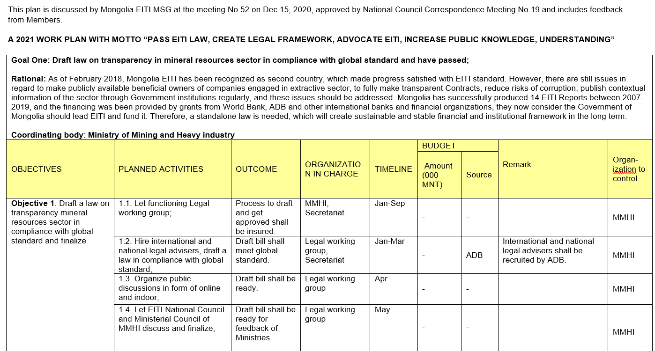
STEP 3: DEFINE OBJECTIVES, ACTIVITIES AND SCOPE
EXAMPLE
Mongolia
EITI work plan identifies the rationale behind each objective
Specifies activities include desired outcomes, timelines, budget and responsible entities
Notes:
CASE STUDIES CAN BE SUBSTITUTE TO MEET REGIONAL NEEDS.

Slide 30

STEP 3: DEFINE OBJECTIVES, ACTIVITIES AND SCOPE
EXAMPLE
OBJECTIVE
Trinidad and Tobago
Work plan identifies activities that are measurable, costed and have clear outcomes
RATIONALE
ACTIVITY
Notes:
CASE STUDIES CAN BE SUBSTITUTE TO MEET REGIONAL NEEDS.

Slide 31
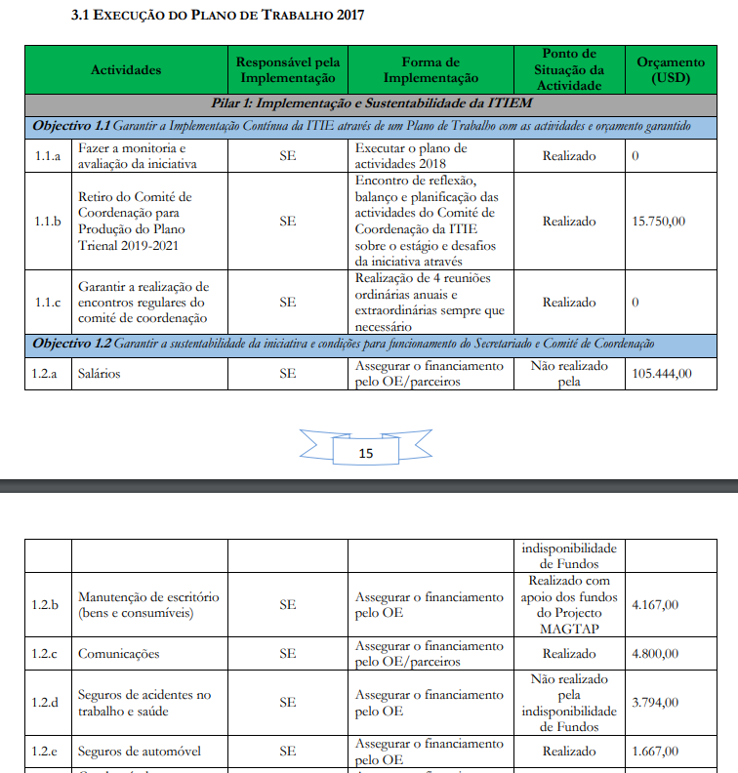
STEP 3: DEFINE OBJECTIVES, ACTIVITIES AND SCOPE
EXAMPLE
Mozambique
Progress report includes information on use of funds for each of the activities
Notes:
CASE STUDIES CAN BE SUBSTITUTE TO MEET REGIONAL NEEDS.

Slide 32

BUILDING A WORK PLAN
STEP 4
Monitor and review

Slide 33
Key questions
STEP 4: MONITOR AND REVIEW
Should objectives or activities be adjusted? Do we need to identify new priorities?
Are we achieving planned outputs this quarter?
Is funding sufficient? Have we executed it well? What needs to improve?
Have we contributed to improving the governance of the extractive activities?
Have we identified/discussed relevant corruption cases?
Notes:
Use the monitoring tool in the work plan to document progress. This can be presented by the secretariat. There are some items that are in the work plan, and other mecahnisms such as bilateral follow-ups which can be

Slide 34
Requirement 1.5(b)
STEP 4: MONITOR AND REVIEW
The multi-stakeholder group is required to undertake an annual progress review of the work plan, which should inform the subsequent work plan.
Previously under Req. 7.4, now merged with Req. 1.5

Slide 35
Annual progress review of work plan
STEP 4: MONITOR AND REVIEW
Progress review must include:
Progress, challenges and changes to objectives and work plan
Activities and outcomes achieved
How stakeholders feedback was obtained
How gender considerations and inclusiveness were taken into account
Expense report

Slide 36



Budget and expense report
STEP 4: MONITOR AND REVIEW
Budget
Expected funding
Expected spend​
Assumptions
Expense report
Actual funding
Actual spend
Explanations on major gaps
Implications for implementation
Notes:
Countries must include a report on actual expenses compared to the work plan budget.
Helps to answer question: what does EITI actually cost?

Slide 37
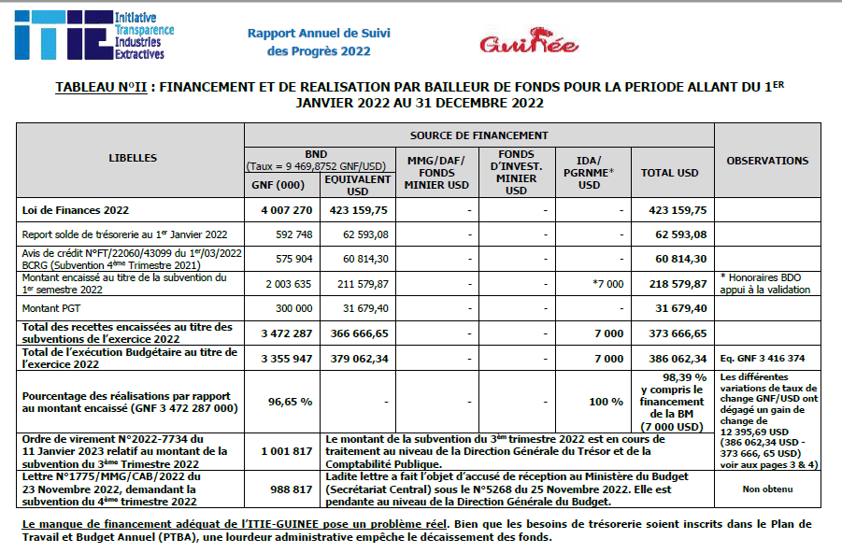
STEP 4: MONITOR AND REVIEW
EXAMPLE
Guinea
EITI annual report is part of ITIE Guinea’s performance assessment by the government

Slide 38

STEP 4: MONITOR AND REVIEW
EXAMPLE
Argentina
Progress Report includes comments from each constituency on progress reached to date

Slide 39
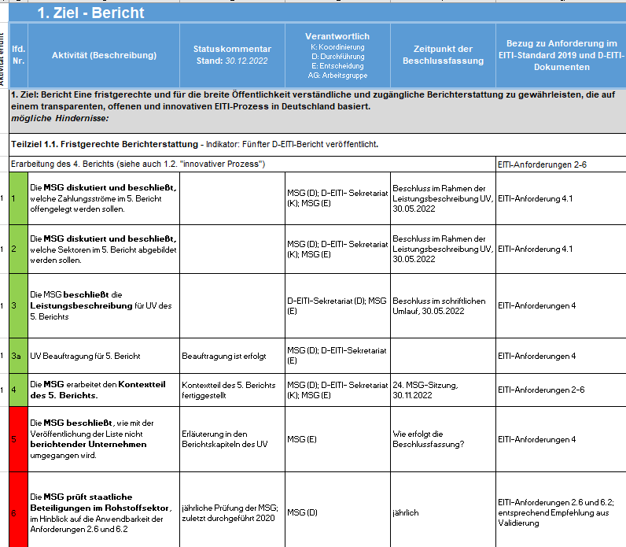
STEP 4: MONITOR AND REVIEW
EXAMPLE
Germany
Progress Report includes final analysis of what was achieved, and what needs to be carried over
Notes:
This can be an annex from the work plan

Slide 40

BUILDING A WORK PLAN
STEP 5
Plan again

Slide 41
Work planning is a cycle
STEP 5: PLAN AGAIN
A sound work plan must be revised annually
Review should be based on progress and opportunities identified
New priorities, topics and actors may arise
Good work plans are based on open and honest discussions with relevant stakeholders

Slide 42


Consult our guidance at eiti.org/guide

Slide 43
Questions?

Slide 44
E-MAIL secretariat@eiti.org PHONE +47 22 20 08 00
ADDRESS EITI International Secretariat, Rådhusgata 26, 0151 Oslo, Norway

