Slide 1
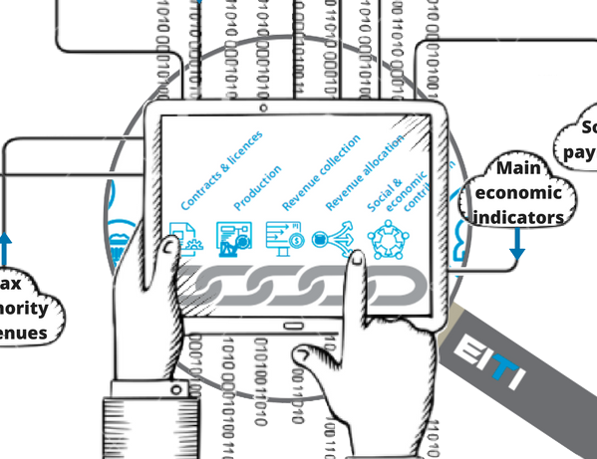
Systematic disclosure Transparency an integral and routine feature of countries governance and management systems
[event]
[date]

Slide 2
Why are we doing so much reconciliation?

Slide 3
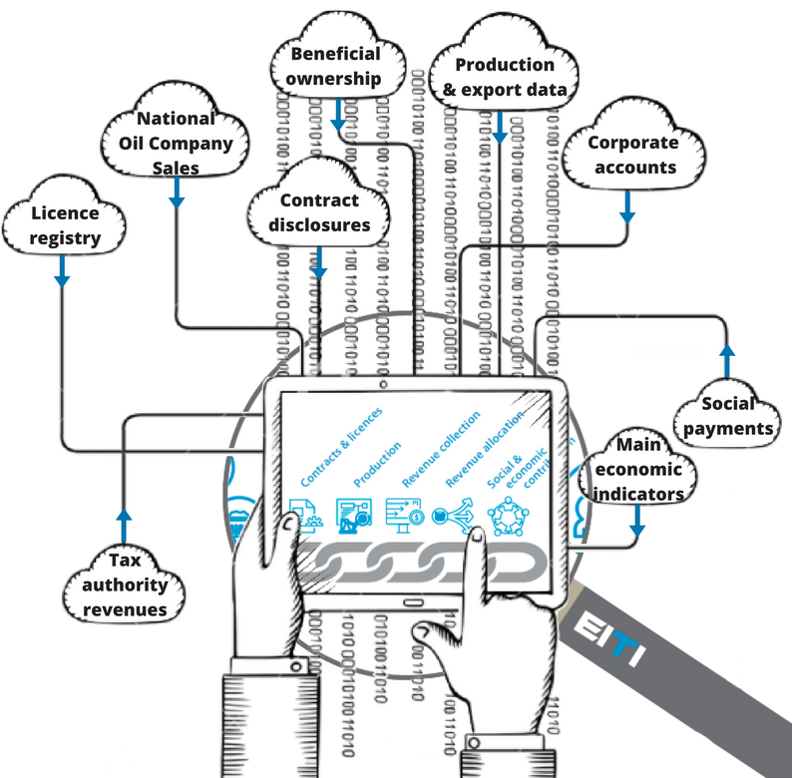
Introducing systematic disclosures
Notes:
Mainstreaming is …
1. Regular publication of EITI data by government and corporate entities
2. With transparent quality assurance of the information
3. Adhering to EITI Requirements

Slide 4
EITI Standard and systematic disclosure
The 2016 Standard provides more flexibility on how data is disclosed:
2013 Standard: “the EITI Report must describe”
2016 Standard: “MSG must disclose”

Slide 5
EITI Standard and systematic disclosure
Mainstreaming EITI disclosures means that governments and company agencies integrate, or systematically disclose, information covered by EITI Requirements.
When disclosures are made regularly, EITI Reports are used as a tool to address gaps in information, if/when needed.

Slide 6
EITI Standard and Mainstreaming
Under EITI Requirement 4.9c, the multi-stakeholder group can avoid reconciliation by an independent administrator if…
there is routine disclosure of the data … and
the financial data is subject to credible, independent audit, applying international standards
Then he MSG may seek Board approval to mainstream EITI implementation

Slide 7
Mapping systematic disclosures
Objective: Explore opportunities for mainstreaming
Instructions:
Based on EITI Requirements, assess whether disclosures are already made public, outside the EITI process.
Are the disclosures compliant to the EITI Standard?
What is missing to comply with the EITI Standard?

Slide 8
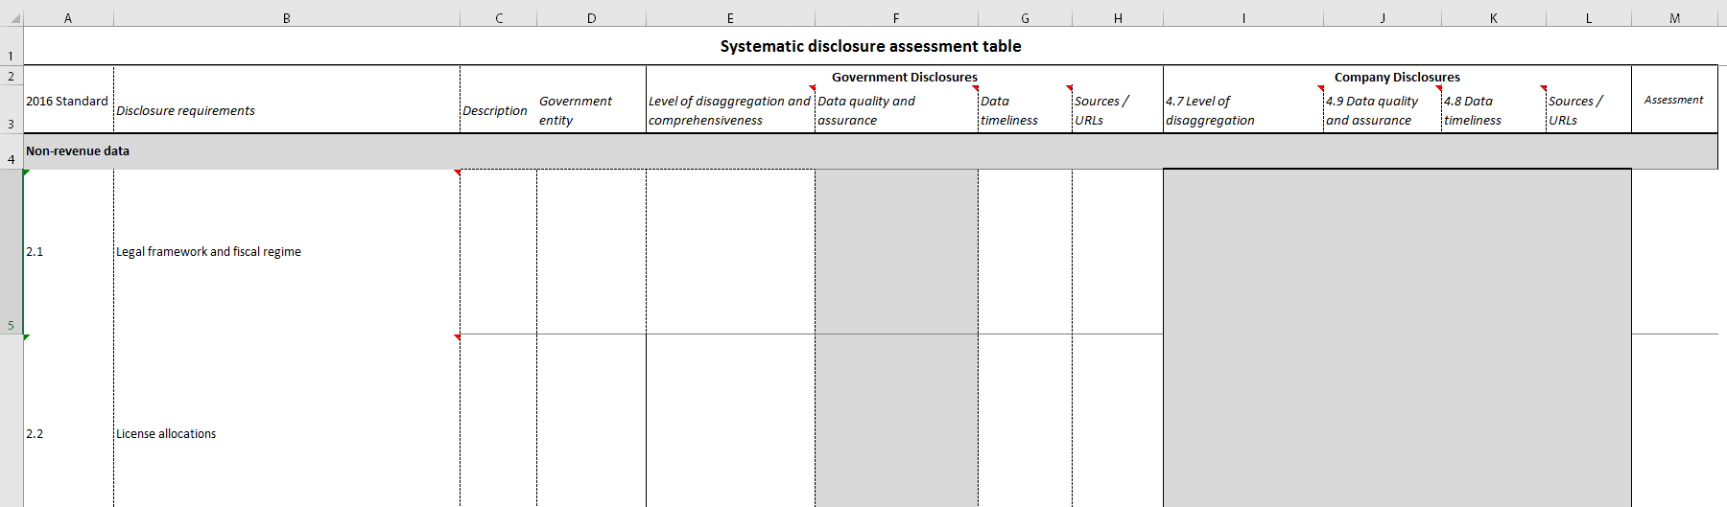
Mapping exercise

Slide 9
Mapping exercise
For each EITI Requirement:

Slide 10
Mapping exercise
For each EITI Requirement:
List what is required to be disclosed

Slide 11
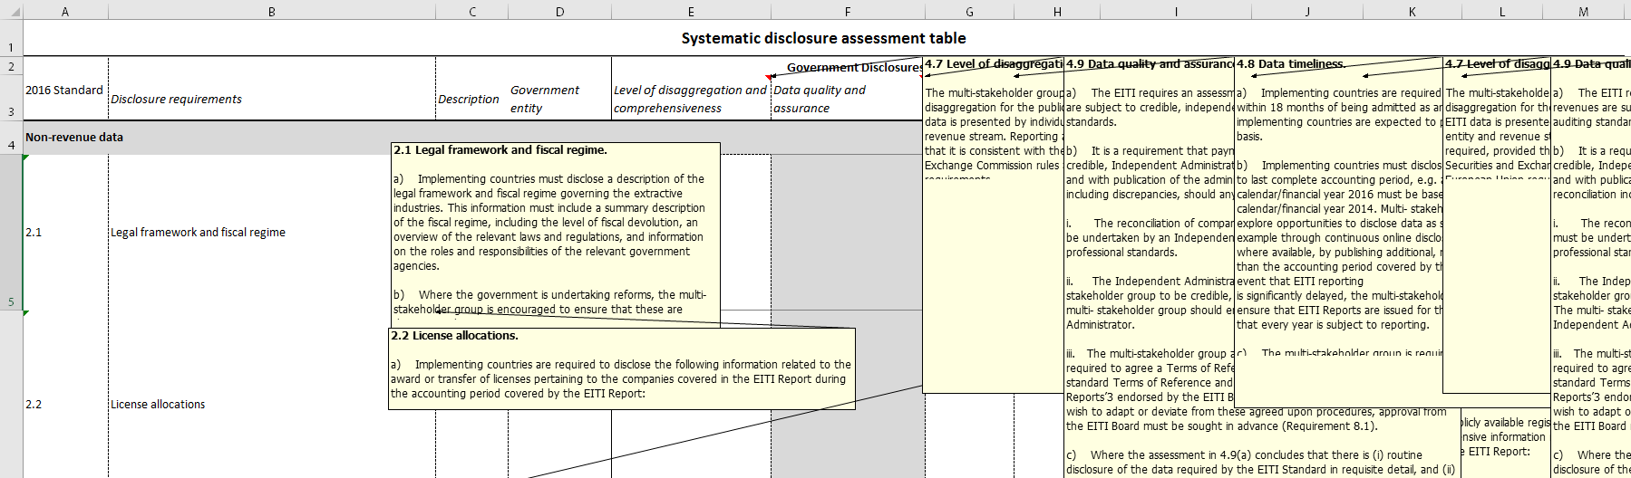
Mapping exercise
For each EITI Requirement:
List what is required to be disclosed (comments in cells explain the requirement)

Slide 12
Mapping exercise
For each EITI Requirement:
List what is required to be disclosed
+ What is disclosed and by whom

Slide 13
Mapping exercise
For each EITI Requirement:
List what is required to be disclosed
+ What is disclosed and by whom
+ Distinguish between government and companies

Slide 14
Mapping exercise
For each EITI Requirement:
List what is required to be disclosed
+ What is disclosed and by whom
+ Distinguish between government and companies
+ Is it comprehensive and detailed enough?

Slide 15
Mapping exercise
For each EITI Requirement:
List what is required to be disclosed
+ What is disclosed and by whom
+ Distinguish between government and companies
+ Is it comprehensive and detailed enough?
+ Is the information reliable? Is it quality assured?

Slide 16
Mapping exercise
For each EITI Requirement:
List what is required to be disclosed
+ What is disclosed and by whom
+ Distinguish between government and companies
+ Is it comprehensive and detailed enough?
+ Is the information reliable? Is it quality assured?
+ How quickly and often is it disclosed / updated

Slide 17
Mapping exercise
For each EITI Requirement:
List what is required to be disclosed
+ What is disclosed and by whom
+ Distinguish between government and companies
+ Is it comprehensive and detailed enough?
+ Is the information reliable? Is it quality assured?
+ How quickly and often is it disclosed / updated
+ Provide direct links to sources

Slide 18
Mapping exercise
For each EITI Requirement:
List what is required to be disclosed
+ What is disclosed and by whom
+ Distinguish between government and companies
+ Is it comprehensive and detailed enough?
+ Is the information reliable? Is it quality assured?
+ How quickly and often is it disclosed / updated
+ Provide direct links to sources
= Assessment: what deviates from EITI Standard?

Slide 19
Mapping exercise
For each EITI Requirement:
List what is required to be disclosed
+ What is disclosed and by whom
+ Distinguish between government and companies
+ Is it comprehensive and detailed enough?
+ Is the information reliable? Is it quality assured?
+ How quickly and often is it disclosed / updated
+ Provide direct links to sources
= Assessment: what deviates from EITI Standard?
Ask the International Secretariat if you have questions and/or need examples

Slide 20
Mapping systematic disclosures
For MSGs and national secretariats, a useful question to ask when performing the exercise is …
“Our latest EITI Report covered fiscal year XXXX (e.g. 2016). Can I find the same information for XXXX+1 (i.e. 2017) already? What disclosures can I find without referencing to any EITI-related documents and websites?”

Slide 21
Common challenges
Technical capacity – excel files are enough
Ensure disclosures are correct if portals exist, and convince agencies and companies to publish excel-/csv-files where none exist.
Resistance to open data
PDF reports mean users must transpose the information to usable formats. Risk of misrepresenting information is reduced by open formats; users will work with original content
Non-disclosure rules
When nondisclosure rules exist; e.g. for corporate income tax
EITI Reports and websites can be used as interim platforms …
… while seeking legal or regulatory changes.

Slide 22
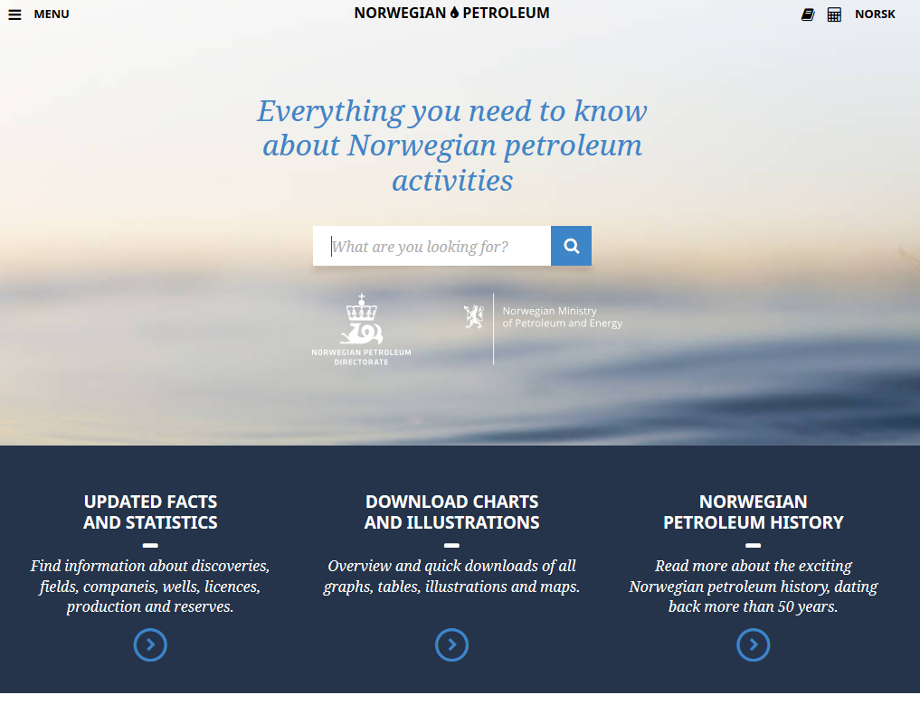
Country examples
First country to move beyond EITI reconciliation reports: Norway
Norway has replaced annual EITI Reports with systematic open data disclosures
Automated online disclosure
Kazakhstan and Mongolia incorporated EITI disclosures in online platforms; extractive companies upload their data alongside their audit statements
Mainstreaming from the start
In Dominican Republic, their website is the EITI Report. Reconciliation report is published as ‘attachment’.
Systematic disclosures can be partial
Does not have to be immediate for all requirements …
… mainstreaming can be partial; sector-by-sector, step-by-step or requirement-by-requirement

Slide 23
Thank you!
www.eiti.org
@EITIorg
Author: EITI International Secretariat
Date: April 2018
Occasion: Systematic disclosure toolkit
Email: secretariat@eiti.org - Telephone: +47 22 20 08 00
Address: EITI International Secretariat, Skippergata 22, 0154 Oslo, Norway

